Slide 1
How to use this resource
Use this resource to help teams make connections between DESSA Skills and the PBIS framework. Refer to the slide notes sections for talking points.
Slide 3 explains why students need DESSA skills to meet school expectations.
Slide 4 (optional) provides an example of aligning DESSA skills to expectations.
Use Slide 5 to align your PBIS with DESSA skills. Populate the table with your own schoolwide expectations and classroom behaviors. Make copies of this, for participants to fill in the “DESSA Skills” column.
Notes:
Slide Purpose: To provide directions to the facilitator on how to use this resource.

Slide 2

DESSA & PBIS Alignment
Insert District/Organization Name
Insert Date
Notes:
Slide Purpose: To introduce the topic of DESSA and PBIS.

Slide 3
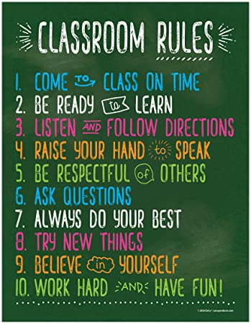
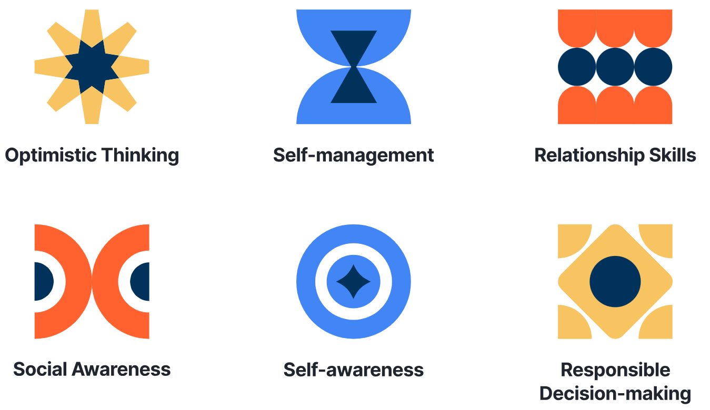
PBIS & DESSA Skills Alignment
Students need these . . .
to be able to do these.
Notes:
Slide Purpose: Explore the connection between DESSA skills and how they help students meet school expectations.
Talking Points:
When we create schoolwide expectations, that helps to create safety through predictability and provides adults with a common language in order to provide kind, specific, and helpful feedback to students about how they are doing demonstrating those expectations.
However, [Click] being ready to learn may require me to be able to identify my skill strengths and needs through self-awareness [Click] . It may require me to use my self-management skills [Click] to manage my nervousness when we’re learning a skill that I’m not yet proficient in. It may require me to use my responsible decision-making skills [Click] to ask for support in a way that will elicit help from an adult versus getting me sent to the office.
If we approach social emotional skill-building or competence from a purely behavioral standpoint, we tend to focus on compliance to expectations and thereby creating a predictable environment, but we may miss the underlying cause for why students are not successfully meeting those expectations.
When students are having difficulty meeting our expectations, we have to identify what skills we may need to teach and foster in students. But how do you pinpoint what skills to teach? Having reliable skill data that you can align to your expectations can support next steps.
So if I were to look at our referrals and students were getting referrals because of not being ready to learn, besides reteaching the expectation to build knowledge, my next step would be to identify social and emotional skills related to that expectation and teach and reinforce those using core PBIS practices.
For example, Hey guys, we’re getting ready to start our science lab. Remember, we’re practicing being ready to learn by using available resources to solve a problem. Who can you ask for help or where can you look for help? (Have students provide responses) Alright, have fun completing your lab. [Once it’s over] I saw several of you look back at your notes or ask your tablemates for support. What a great job being ready to learn!
Now that I’ve modeled this, it’s your turn.

Slide 4
Building Skills: Partner Activity
Schoolwide Expectation | Classroom | DESSA Skills (K-8 Teacher Rating Sample)
Be Safe | Walk at all times Keep hands, feet and objects to yourself Use classroom materials appropriately | Stay focused despite a distraction (SM) Think before they acted (SM)
Be Respectful | Follow instructions Use kind words and actions
Be Responsible | Pay attention to your teacher Raise your hand to speak Be ready to learn Try your best Stay on task Participate
Notes:
Slide Purpose: Directions for facilitating a partner activity.
Talking Points:
On the screen you see some fairly common schoolwide expectations along with behavioral look for’s in the classroom. To round out our matrix, it’s your job now to identify some social-emotional skills that students may need to successfully demonstrate those behavioral look for’s and, therefore, meet the expectation. I’ve done the first one for you by identifying some skills from the self-management competency from the DESSA K-8 teacher rating.
Resources:
DESSA 2 scales and associated items: https://selcompass.zendesk.com/hc/en-us/articles/28652992475021-DESSA-2-Scales-and-Associated-Items
DESSA HSE scales and associated items: https://selcompass.zendesk.com/hc/en-us/articles/360046513611-DESSA-High-School-Edition-HSE-Teacher-Form-Scales-and-Associated-Items
Middle School Self-Report scales and associated items: https://selcompass.zendesk.com/hc/en-us/articles/18132331209101-DESSA-MSE-SSR-Scales-and-Associated-Items
High School Self-Report scales and associated items: https://selcompass.zendesk.com/hc/en-us/articles/18132256362125-DESSA-HSE-SSR-Scales-and-Associated-Items

Slide 5
PBIS at (Insert School Name)
Schoolwide Expectation | Classroom | DESSA Skills
Notes:
Slide Purpose: To connect DESSA skills to school/site specific PBIS expectations.
Directions: Fill this table with your own schoolwide expectations and classroom behaviors, either as a group or breakout students into small groups to complete the table.
Resources:
DESSA 2 scales and associated items: https://selcompass.zendesk.com/hc/en-us/articles/28652992475021-DESSA-2-Scales-and-Associated-Items
DESSA HSE scales and associated items: https://selcompass.zendesk.com/hc/en-us/articles/360046513611-DESSA-High-School-Edition-HSE-Teacher-Form-Scales-and-Associated-Items
Middle School Self-Report scales and associated items: https://selcompass.zendesk.com/hc/en-us/articles/18132331209101-DESSA-MSE-SSR-Scales-and-Associated-Items
High School Self-Report scales and associated items: https://selcompass.zendesk.com/hc/en-us/articles/18132256362125-DESSA-HSE-SSR-Scales-and-Associated-Items

