Slide 1

DESSA Data Results
Insert District/Organization Name
Insert Date

Slide 2
DESSA Overview
What is the DESSA?
The DESSA is a suite of trusted, evidence-based assessments and screeners to measure students’ critical resilience skills, identify strengths, and support growth with data-driven instructional resources.
What is the purpose/goal of implementing this assessment?
Insert
Notes:
Slide Purpose: To provide an overview of the DESSA and highlight the specific goal of using the DESSA in your organization.
Share the DESSA overview and add information to the second question, as it relates to your specific organization or program.

Slide 3
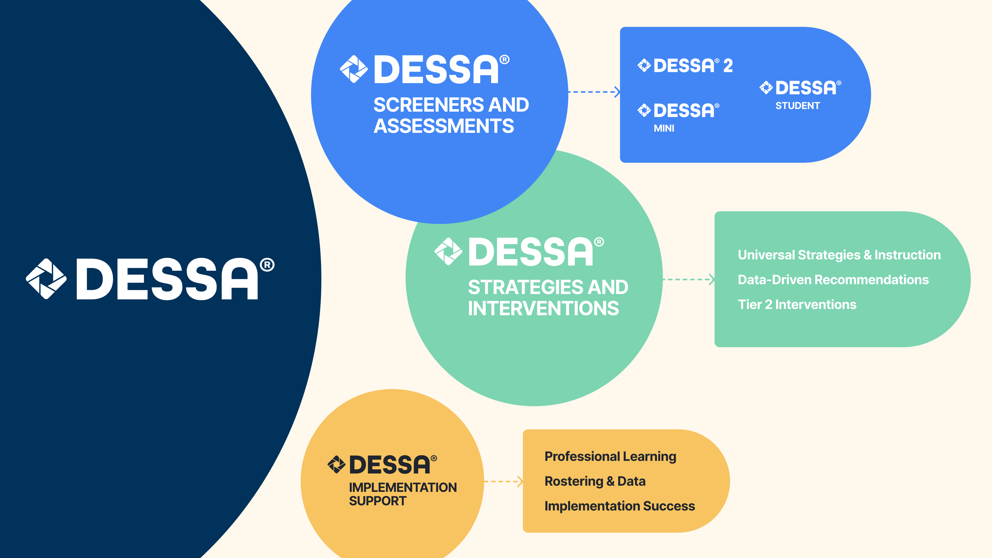
DESSA Data Collection
Insert rating window/timeline: pre/mid/post assessment, date range
Insert ratings completed for: grade levels specific classes, homeroom, etc.
Insert ratings completed by: teachers, counselors, students, etc.
Notes:
Slide Purpose: To provide a review of the data collected.
Share a recap of the collected data, included:
Rating window/timeline: pre/mid/post assessment, date range
Ratings completed for: grade levels, specific classes, homeroom, etc.
Ratings completed by: teachers, counselors, students, etc.

Slide 4
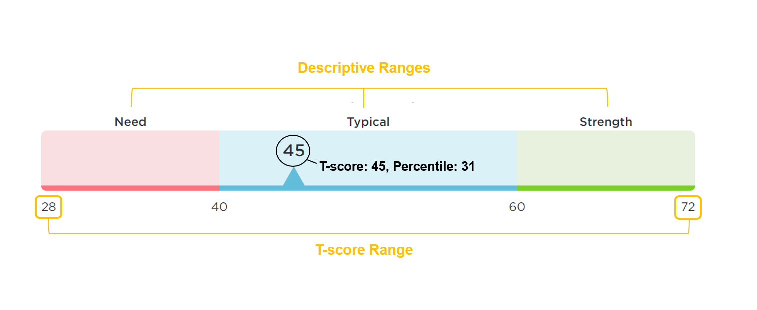


DESSA Assessment Results
Video: Understanding DESSA Scores
Notes:
Slide Purpose: To provide a review of the DESSA assessment results.
Share a recap of the assessment results in the visual, including:
The DESSA assessments report results using T-scores, which are categorized into three descriptive ranges: Strength, Typical, and Need for Instruction.
T-Scores range from 28-72.
Scores of 60 and above are considered a Strength
Scores between 41-59 are considered Typical (demonstrating typical patterns of development)
Scores of 40 and below indicate a Need for Instruction
Note: The term Need for Instruction was thoughtfully chosen to convey that a student has not yet acquired these skills. As a strength-based assessment, this score increases the awareness that a student requires support and instruction for their continued development and time to practice these skills.

Slide 5
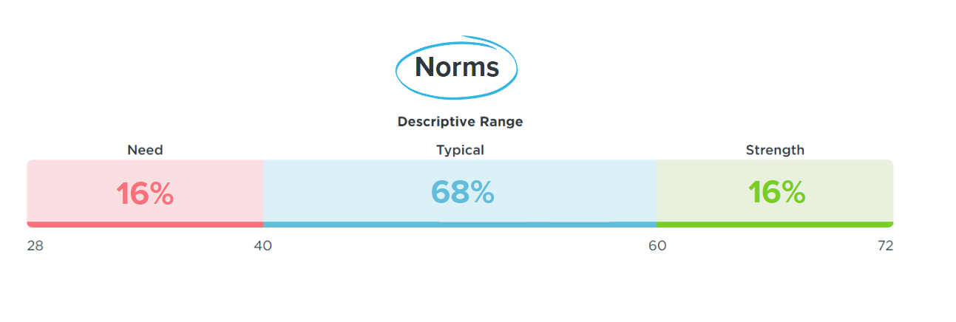
DESSA Assessment Norms
Notes:
Slide Purpose: To provide a review of the DESSA assessment norms.
The DESSA assessments are nationally standardized and norm-referenced.
From the standardization sample, we can anticipate that:
68% of student scores will indicate they are demonstrating Typical patterns of social and emotional skill development,
16% of student scores will demonstrate a Strength in their social and emotional skills
16% of student scores will indicate a Need for Instruction.

Slide 6
DESSA Data Review
Review results for: (insert applicable groups)
  District/organization-wide
  School/program-wide
  Grade level
  Classroom
  Competencies
  Custom Group (Tier 2/ MTSS)
  Individual student results
Video: Accessing Data Ratings in the DESSA System
Notes:
Slide Purpose: To provide a high-level overview of the data that will be reviewed with the intended audience.
Share what data the audience can expect to review, such as:
District/organization wide
School/program wide
Grade level
Content/subject area
Classroom
Small group/Tier 2/MTSS focus
Individual student results

Slide 7
DESSA Results by Report
Notes:
Slide Purpose: Transition slide
In this section, we’ll look at the DESSA results by report, followed by some guiding questions and actions to consider based on the data.

Slide 8
District-Wide Results
Total students assessed: Insert number
Strength: Insert number/percent
Typical: Insert number/percent
Need for Instruction: Insert number/ percent
DESSA System Report:
My Students
Insert screenshot from
DESSA System (optional)
Notes:
Slide Purpose: To review foundational (descriptive range) results at the district level.
Locate this information within the DESSA System by either viewing the graph on the right side of the Dashboard OR navigating to the Data and Insights tab and selecting the My Students report.
Select the desired “Rating Window” and “Form” filter or choose the Start/End date filters, click apply.
The total number of students rated, hover over each bar on the graph.
DESSA System View: Consider adding a slide with a screenshot of the report results in the DESSA System or displaying the DESSA System to model navigating through the platform.

Slide 9
Considerations for Reviewing District-Wide Results
Are results what you expected?
Action: Use reflection prompts such as “I am curious about…” or “Some patterns or trends I notice are…”
What does DESSA implementation currently look like?
Action: Discuss changes to implementation and adjustments to existing systems that can address any differences in results.
What additional training and/or resources are needed?
Action: Consider professional development opportunities and support from leadership.
Notes:
Slide Purpose: To provide guiding questions and action steps for consideration while reviewing district-wide results.
Use the prompts to discuss data results at the district level.

Slide 10
School-Wide Results
Total students assessed: Insert number
Strength: Insert number/percent
Typical: Insert number/percent
Need for Instruction: Insert number/ percent
DESSA System Report:
My Students
Insert screenshot from
DESSA System (optional)
Notes:
Slide Purpose: To review foundational (descriptive range) results at the school level.
Locate this information within the DESSA System by navigating to the Data and Insights tab and selecting the My Students report. Select the school under the “Site” filter.
Select the desired “Rating Window” and “Form” filter or choose the Start/End date filters, click apply.
The total number of students rated, hover over each bar on the graph.
DESSA System View: Consider adding a slide with a screenshot of the report results in the DESSA System or displaying the DESSA System to model navigating through the platform.

Slide 11
School-Wide Results
What do you notice about your site’s distribution vs. the expected distribution: Strength 16%, Typical 68%, and Need for Instruction 16%
Action: Consider what might influence these distributions, such as implementation practices and educator (rater) training.
How does the culture of the school and classroom (relationships, routines, procedures) support student outcomes?
Action: Explore the Foundational Practices and Strategy resources that would support student growth to implement school-wide. Resources are located under the “Strategies” tab in the Educator Portal.
Notes:
Slide Purpose: To provide guiding questions and action steps for consideration while reviewing school-wide results.
Use the prompts to discuss data results at the school level.

Slide 12
Grade Level Results
Grade: Insert
Strength: Insert number/percent
Typical: Insert number/percent
Need for Instruction: Insert number/percent
Grade: Insert
Strength: Insert number/percent
Typical: Insert number/percent
Need for Instruction: Insert number/percent
Grade: Insert
Strength: Insert number/percent
Typical: Insert number/percent
Need for Instruction: Insert number/percent
DESSA System Report:
Grade Level
Insert screenshot from
DESSA System (optional)
Notes:
Slide Purpose: To review foundational (descriptive range) results at the grade level.
Locate this information within the DESSA System by navigating to the Data and Insights tab and selecting the Grade Level report.
Select the desired “Rating Window” and “Form” filter or choose the Start/End date filters, click apply.
*Duplicate slide or adjust for additional grade levels as needed.
DESSA System View: Consider adding a slide with a screenshot of the report results in the DESSA System or displaying the DESSA System to model navigating through the platform.

Slide 13
Considerations for Reviewing Grade Level Results
Are there any grades that differ significantly, in either positive or negative ways?
Action: Consider scheduling regular meetings to discuss implementation best practices.
What goals for supporting student growth across grade levels are in place?
Action: Align existing goals and systems of support to include DESSA data to meet set goals.
What additional training and/or resources are need?
Action: Explore the self-paced training courses and On-Demand Video Library resources, located under the “Training” tab of the Educator Portal.
Notes:
Slide Purpose: To provide guiding questions and action steps for consideration while reviewing grade level results.
Use the prompts to discuss data results at the grade level.

Slide 14
Classroom Results
Class: Insert
Total students assessed: Insert number
Strength: Insert number/percent
Typical: Insert number/percent
Need for Instruction: Insert number/ percent
DESSA System Report:
My Students
Insert screenshot from
DESSA System (optional)
Notes:
Slide Purpose: To review foundational (descriptive range) results at the classroom level.
Locate this information within the DESSA System by navigating to the Data and Insights tab and selecting the My Students report. Select the school under the “Site” filter.
Select the desired “Rating Window” and “Form” filter or choose the Start/End date filters, click apply.
DESSA System View: Consider adding a slide with a screenshot of the report results in the DESSA System or displaying the DESSA System to model navigating through the platform.

Slide 15
Considerations for Reviewing Classroom Results
Review the classroom results for each descriptive range. Which category did the majority of students score?
Action: Based on the data, school a skill (competency) area to focus on with the entire class. Consider starting by building on students’ collective strengths.
Do disaggregated results suggest a need for reflection, discussion, or additional student support?
Action: Analyze results by student population to determine if there are differences in results based on racial/ethic, gender, student services (e.g. EL, SEPD) groups. Use the filter features to generate these results.
Notes:
Slide Purpose: To provide guiding questions and action steps for consideration while reviewing classroom level results.
Use the prompts to discuss data results at the classroom level.

Slide 16
Competencies Results
Strengths:
Insert areas with higher collective scores
Opportunities for Growth:
Insert areas with collective lower scores
DESSA System Report:
Competencies
Insert screenshot from
DESSA System (optional)
Notes:
Slide Purpose: To review foundational (descriptive range) results at the competencies level.
Locate this information within the DESSA System by navigating to the Data and Insights tab and selecting the Competencies report.
Select the desired “Rating Window” and “Form” filter or choose the Start/End date filters, click apply.
*Duplicate slide or adjust for additional grade levels as needed.
DESSA System View: Consider adding a slide with a screenshot of the report results in the DESSA System or displaying the DESSA System to model navigating through the platform.

Slide 17
Considerations for Reviewing Competencies Results
Which competency areas demonstrate relative Strengths that can be leveraged?
Action: Engage students in celebrating their strengths! Check out the resources within the “Strategies” tab to facilitate lessons and activities that continue to build students’ skills.
Which competency areas demonstrate a collective Need for Instruction?
Action: Identify students for intervention and support groups. Focus targeted interventions on areas of need, using the Strategies and Tier 2 Intervention resources.
.
Notes:
Slide Purpose: To provide guiding questions and action steps for consideration while reviewing competency results. Note that this data is available for the DESSA 2 (full assessment), Student Self-Report (SSR), and DESSA Second Step Edition (SSE) assessments.
Use the prompts to discuss data results at the competencies level.

Slide 18

Custom Group
Group: Insert
Report: Insert
Total students assessed: Insert number
Strength: Insert number/percent
Typical: Insert number/percent
Need for Instruction: Insert number/ percent
DESSA System Report Feature:
Custom Group Filter
Insert screenshot from
DESSA System (optional)
Video: Using the Custom Group Filter
Notes:
Slide Purpose: To review foundational (descriptive range) results for students in a custom group.
Locate this information within the DESSA System by navigating to the Data and Insights tab and selecting the My Students report. Select the school under the “Site” filter.
Select the desired “Rating Window” and “Form” filter or choose the Start/End date filters, click apply.
DESSA System View: Consider adding a slide with a screenshot of the report results in the DESSA System or displaying the DESSA System to model navigating through the platform.

Slide 19
Considerations for Reviewing Custom Group
What additional information and context is important for reviewing results for the students within this custom group?
Action: Gather additional data and information, such as attendance data, academic needs, qualifying student services, out-of-school content, and student input.
What supports are in place for students within this custom group?
Action: If intervention groups have not yet been established, consider:
  Staff members identified to facilitate targeted interventions
  The focus for interventions, based on DESSA results
  The intervention schedule and ways skills can be reinforced in Tier 1 settings.
Notes:
Slide Purpose: To provide guiding questions and action steps for consideration while reviewing custom group results.
Use the prompts to discuss data results for custom groups.
Video: Using Custom Groups - https://screenpal.com/watch/c0XoouVGybu

Slide 20
Individual Student Results
Student: Insert
Assessment Form: Insert
Descriptive Range: Insert
T-Score: Insert
Additional Information: Include areas such as attendance data, student services/eligibility, behavior data, and out-of-school status or events.
DESSA System Report:
My Student,
Individual Student Profile
Insert screenshot from
DESSA System (optional)
Notes:
Slide Purpose: To review foundational (descriptive range) results at the individual student level.
Locate this information within the DESSA System by navigating to the Data and Insights tab and selecting the My Students report.
Use the filters to locate an individual student within the table below the bar graph or search for a student’s name or ID number in the search bar (top right corner of the DESSA System).
Select the “Form” filter or choose the Start/End date filters, click apply.
*Duplicate slide or adjust for additional students, as needed.
DESSA System View: Consider adding a slide with a screenshot of the report results in the DESSA System or displaying the DESSA System to model navigating through the platform.

Slide 21
Considerations for Reviewing Individual Student Results
What are the results by reviewing the descriptive range and the t-score?
Action: Identify students for intervention and support groups. Focus targeted interventions on areas of need, using the Strategies and Tier 2 Intervention resources.
If available, which competency area has the highest T-score? Which area has the lowest T-score?
Action: Engage students in celebrating their strengths! Check out the resources within the “Strategies” tab to facilitate lessons and activities that continue to build students’ skills.
Notes:
Slide Purpose: To provide guiding questions and action steps for consideration while reviewing individual student results.
Use the prompts to discuss data results at the individual student level.

Slide 22
What’s Next?
Notes:
Slide Purpose: Transition slide
In this section, we’ll explore some key takeaways, celebrate some strengths, and consider next steps for our DESSA implementation.

Slide 23
Key Takeaways
Based on the DESSA results reviewed today, some key takeaways include:
Insert
Insert
Insert
Notes:
Slide Purpose: To provide an opportunity to share or brainstorm some key takeaways based on the DESSA results share.
Insert key takeaways OR consider inviting the group to brainstorm their takeaways to share out as a group.

Slide 24
Celebrating Strengths
Based on the DESSA results review, what are strengths that we can celebrate together?
Notes:
Slide Purpose: To collect feedback and input from staff members.
Insert directions for how staff can share their feedback and input. Consider facilitating an engagement activity (such as a small group brainstorm or gallery walk), linking a digital form, or open it up for a whole group discussion.

Slide 25
What’s Next?
After reviewing and analyzing DESSA results, we will:
Insert
Insert
Insert
Notes:
Slide Purpose: To provide an opportunity to share what to expect next for DESSA implementation.
Insert next steps as it relates to your specific organization or program.

Slide 26
Feedback & Input
Successful and sustainable implementation and data collection involves feedback and input from staff members.
Share with us your thoughts, ideas, and suggestions by:
(insert method for obtaining feedback)
Notes:
Slide Purpose: To collect feedback and input from staff members.
Insert directions for how staff can share their feedback and input. Consider facilitating an engagement activity (such as a small group brainstorm or gallery walk), linking a digital form, or open it up for a whole group discussion.

Slide 27
Wrapping Up
Notes:
Slide Purpose: Transition slide
To wrap up our review today, we’ll consider some final actions and resources.

Slide 28
Additional Considerations
Review implementation practices and determine any adjustments needed.
Ensure educators and leaders access and complete training materials, located under the “Training” tab in the DESSA System.
Continue analyzing assessment results using the Analyzing Tiered Data: Report Guides resource.
Notes:
Slide Purpose: To provide foundational action steps to consider during the DESSA implementation process.
Share concrete action steps with the audience, adding your own to customize direction.

Slide 29
Resources
DESSA System Support Portal
On-Demand Video Library
Analyzing Tiered Data: Report Guides
DESSA Data Action Plans
Implementation Guides:
  DESSA 2 K-8th
  DESSA Middle School
  DESSA High School
  DESSA Second Step Edition
Talking to Your Students about their SSR Data
Contact DESSA:
Insert email
Notes:
Slide Purpose: To provide quick links to applicable resources for using DESSA data.
All resources are located in the DESSA System, either under the “Training” tab or in the Support Portal (Question Mark Circle in the top right corner).

