Slide 1
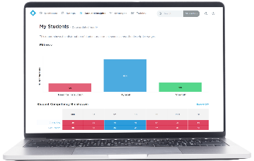
SCREENERS AND ASSESSMENTS
TRAINING AND PROFESSIONAL DEVELOPMENT
Notes:
Action: Customize this slide for your district by removing any products that were not a part of your purchase
Talking Points: The DESSA System is a suite of actionable, strength-based, and data-driven tools that prepare students with the social emotional skills for success in school and beyond. This includes educator- and student-completed assessments to measure student social and emotional competence, instructional strategies and interventions so that we can easily take action from our data, and SEL professional development. With DESSA, we can be confident that we are leading with strengths, fostering students’ holistic development, and making a meaningful impact on students’ lives.

Slide 2
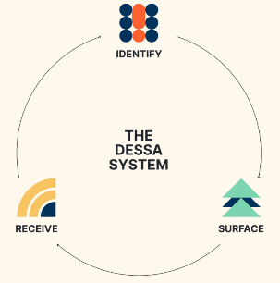
At <insert school district/organization name>, we know that social and emotional competence is essential so that students can thrive academically and as responsible and compassionate individuals in their communities.
We’ve partnered with DESSA to provide you with tools to proactively assess student needs, create easy and effective skill-building plans, improve academic outcomes, and cultivate a positive school climate.
Notes:
Action: Customize highlighted content
Talking Points: At <insert school district/organization name>, we know that social and emotional competence is essential so that students can thrive academically and as responsible and compassionate individuals in their communities.
We’ve partnered with DESSA to provide you with tools to proactively assess student needs, create easy and effective skill-building plans, improve academic outcomes, and cultivate a positive school climate.

Slide 3
Developing DESSA competencies transforms student behavior
Proactive assessment and tailored student support for one of their district partners resulted in:
Average increase
in course
completion
Reduction in
referrals
Reduction of in school suspensions
Reduction out of school suspensions
Connecting Social-Emotional Development, Academic Achievement, and On-Track Outcomes (May 2020)
Notes:
Talking Points: Working on the skills that DESSA measures positively impacts the academic and behavior outcomes our district cares about. Another district using DESSA saw a 44% increase in course completion, and reductions in referrals, in school suspensions, and out of school suspensions.

Slide 4
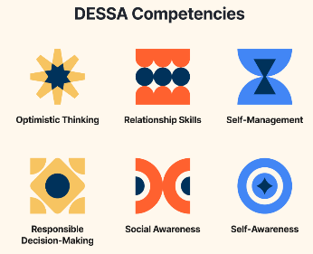
Insert future meetings/communications where they’ll learn more about the “why” and vision for your Aperture program
Insert training date
In the meantime, please contact <insert point of contact> with any initial questions or ideas you might have.
Ready to learn more?
Check out the DESSA online at Apertureed.com
Notes:
Action: Customize highlighted content
Talking Points: We will share more information about what this initiative means for you <insert the next time they will hear about DESSA, such as in a meeting or future email>. In the meantime, please contact <insert point of contact> with any initial questions or ideas you might have.

