Slide 1
Getting Started with the DESSA Student Self-Report (SSR)
Notes:
Note to the Educator:
This student-facing resource is designed to support the overall implementation of the DESSA Student Self-Report (SSR) for middle and high school grades.
It includes foundational information to share with students, embedded opportunities for student engagement, step-by-step directions for accessing the Student Portal features, and additional resources.
Suggestions:
Prior to facilitation, preview the slide deck and adjust it for your students, as needed. Connect with your site-based administrator for implementation details that can be shared with students.
Visit the Aperture Education Support Portal for more information and to submit a support request: https://selcompass.zendesk.com/hc/en-us

Slide 2
What are we doing today?
You will reflect on your social and emotional skills to learn about your strengths and areas you may want to develop further (growth opportunities).
Why is it valuable?
These skills can support you academically, but can also support your personal wellbeing and relationships. These skills also support college, career, and workforce readiness!
Notes:
Note to the Educator:
The purpose of this slide is to introduce the topic of measuring social and emotional skills and highlight why this process is important.
Suggestions:
Connect with your district, school, or program administrator for specific implementation details that may be relevant to share with students.
Consider aligning existing initiatives to the DESSA SSR, such as:
PBIS
MTSS
College, career, and workforce readiness or Portrait of a Graduate programming
Share an SEL Skill you use in your role, and/or a skill you are working on

Slide 3
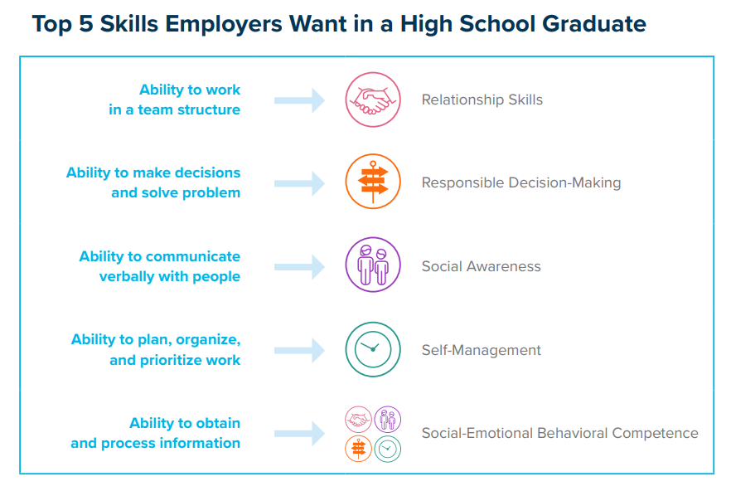
Top 5 Skills Employers Want in a High School Graduate
Notes:
Note to the Educator:
The purpose of this slide is to highlight how SEL skills support students with career readiness

Slide 4
Student Portal Preview
Notes:
Slide Purpose: To review a Student Portal overview video (also located in the MS SSR Intro LMS course).
Talking points:
Let’s take a look at an overview of the Student Portal! We’ll be sure to expand on these details following the short video.
If needed, ScreenPal for “Student Portal Overview” link: https://screenpal.com/watch/c0ji0pVkKO2

Slide 5
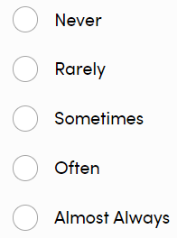
What will the questions look like? Grades 6-8 | 50 questions
Answer Selection Options
Do your best to rate yourself.
I set goals for myself.
I show appreciation for others.
I feel comfortable being myself in different situations.
Notes:
Slide Purpose: To provide example questions asked on the MS SSR.
Talking points:
As a reminder, the questions asked on the MS SSR are strength based. Here we have a few examples. For 6th-8th graders, the sentence stem will always begin with “Do your best to rate yourself.”
The answer options include never, rarely, sometimes, often, and almost always. If you have students who may need support in identifying the difference, this may be a piece you can visit as a whole class.

Slide 6
What will the questions look like? Grades 9-12 | 55 questions
Answer Selection Options
During the past 4 weeks, how often did you…
Think about positive things?
Ask somebody for feedback?
Get along well with different types of people?
Notes:
Slide Purpose: To provide example questions asked on the HS SSR.
Talking points:
As a reminder, the questions asked on the HSS SSR are strength based. Here we have a few examples. For 9th-12th graders, the sentence stem will always begin with “During the past 4 weeks, how often did you…”
The answer options include never, rarely, sometimes, often, and almost always. If you have students who may need support in identifying the difference, this may be a piece you can visit as a whole class.

Slide 7
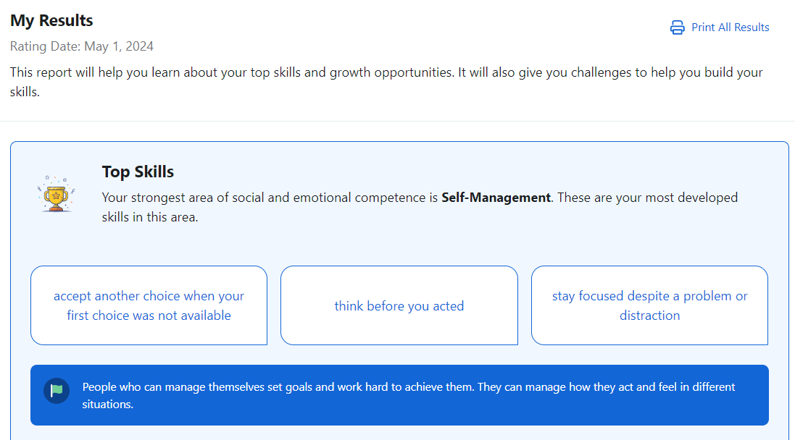
What will my results look like?
First, you’ll learn…
Your Top Skill
Specific ways you shine with this skill
Why this skill is important
Notes:
Note to the Educator:
Share with students that they will have access to their results in real time after they complete the DESSA SSR in the Student Portal.
Share with students who else will be able to see their results, such as their assigned educator, counselors, administrators, etc. Connect with your administrator for site-specific implementation details, as needed.

Slide 8
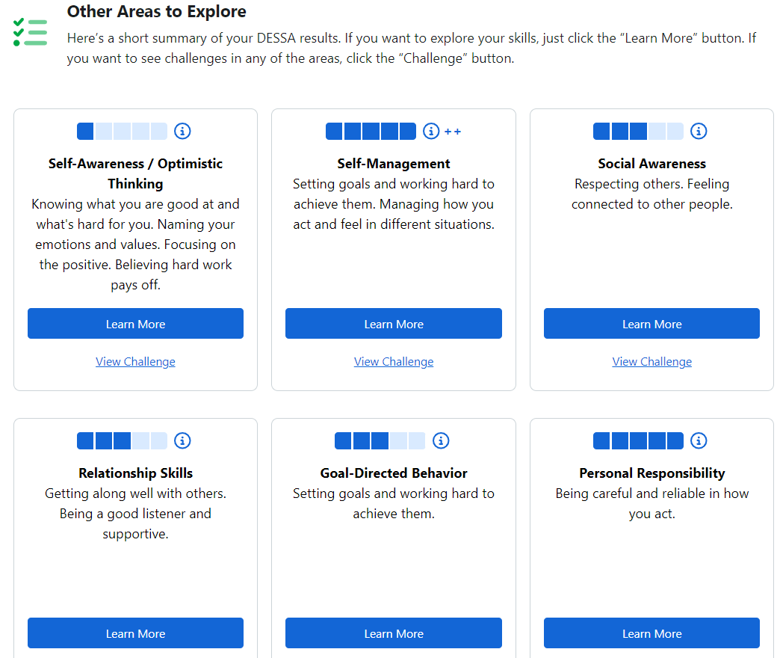
What will my results look like?
Then, you’ll be able to explore your skills in other competencies
Notes:
Note to the Educator:
Share with students that they will have access to their results in real time after they complete the DESSA SSR in the Student Portal.
Share with students who else will be able to see their results, such as their assigned educator, counselors, administrators, etc. Connect with your administrator for site-specific implementation details, as needed.

Slide 9
Let’s Get Started!
Notes:
Note to the Educator:
This student-facing resource is designed to support the overall implementation of the DESSA Student Self-Report (SSR) for middle and high school grades.
It includes foundational information to share with students, embedded opportunities for student engagement, step-by-step directions for accessing the Student Portal features, and additional resources.
Suggestions:
Prior to facilitation, preview the slide deck and adjust it for your students, as needed. Connect with your site-based administrator for implementation details that can be shared with students.
Visit the Aperture Education Support Portal for more information and to submit a support request: https://selcompass.zendesk.com/hc/en-us
Review the Support Portal Article: How to Talk to Your Students about Their SSR Data: https://selcompass.zendesk.com/hc/en-us/articles/16362862103565-Talking-to-Students-About-Their-SSR-Data AND Responding to Student Self-Report Data: https://selcompass.zendesk.com/hc/en-us/articles/7150556819469-Responding-to-DESSA-Student-Self-Report-Data

Slide 10
Log into your Student Portal
Option 1
Direct the students to go to: https://student.apertureed.com/login
Select First Time User? Register Now
Enter student username generated from the DESSA System
Enter their Student ID
Create a password
Re-enter the password
Accept the Privacy Policy, Terms, and Conditions.
Complete registration and login
Student Portal Account Registration
& Login Options
Log in using website
Log in using QR Code
Option 2
Students can scan the unique QR code to the right of their information to take them directly to the registration screen and complete steps 1-7 above.
Notes:
Slide Purpose: To explain the two ways in which students may access their account. Check with your program administrator to confirm if students will log in with SSO, or username + password
Educator Note*: Prior to student’s logging in for the first time to the student portal, they will need to register. You can find each of your student’s registration information on by going to your admin menu and clicking on the student self-report button. Once you are on the student self-report page, click the “Register Students” button above the table with student information. This will take you to screen that you can print with each student’s unique username and QR code to use to register. It would be helpful to print this list and cut out each student before student training.
Talking points:

Slide 11
Log into your Student Portal- SSO Option
Option 1
Select First Time User? Register Now
Enter student username generated from the DESSA System
Enter their Student ID
Accept the Privacy Policy, Terms, and Conditions
Complete registration and login
The next time the students need to access the DESSA Student Portal, they will click on the Aperture Ed app in their SSO portal and go immediately to their Student Self-Report
Student Portal Account Registration
Using SSO
Single Sign On (SSO):
Clever
ClassLink
Log in using QR Code
Option 2
Students can scan the unique QR code to the right of their information to take them directly to the registration screen and follow steps 1-5 above.
Notes:
Slide Purpose: To explain the two ways in which students may access their account. Check with your program administrator to confirm if students will log in with SSO, or username + password
Educator Note*: Prior to student’s logging in for the first time to the student portal, they will need to register. You can find each of your student’s registration information on by going to your admin menu and clicking on the student self-report button. Once you are on the student self-report page, click the “Register Students” button above the table with student information. This will take you to screen that you can print with each student’s unique username and QR code to use to register. It would be helpful to print this list and cut out each student before student training.

Slide 12
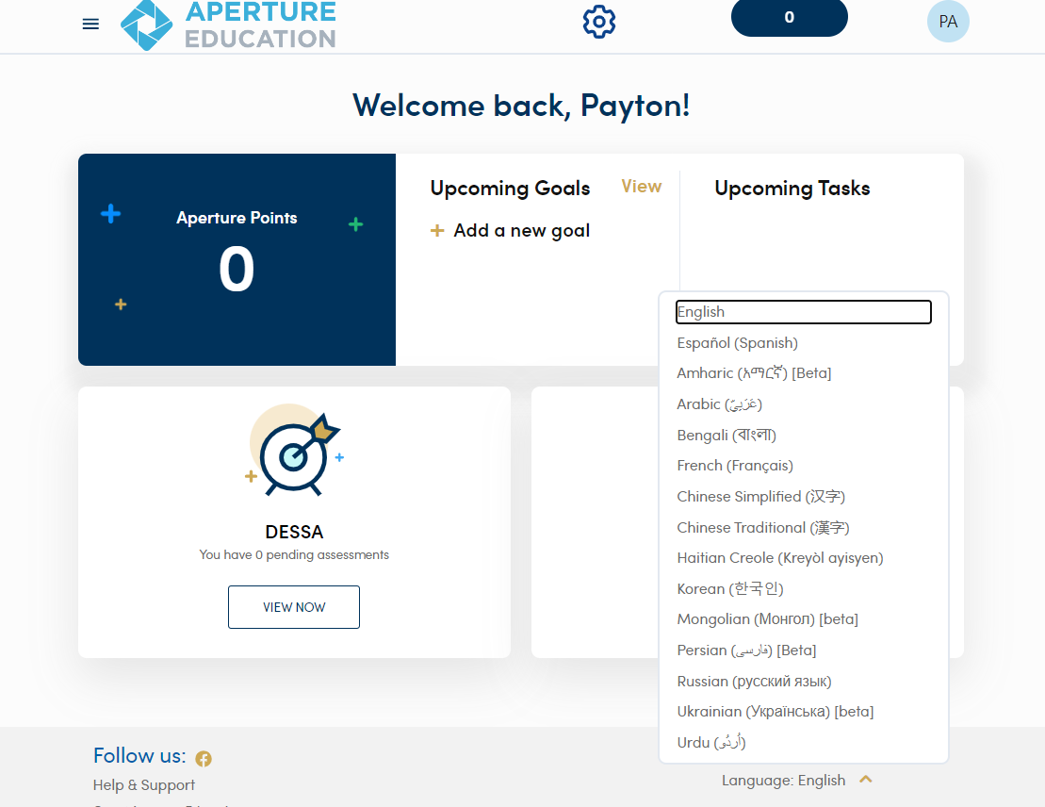
Completing the DESSA
After logging in:
Select your language in the Student Portal.
Notes:
Note to the Educator:
Activity Purpose: Students complete the DESSA in their Student Portal.
Review Step 2 of completing the DESSA.

Slide 13
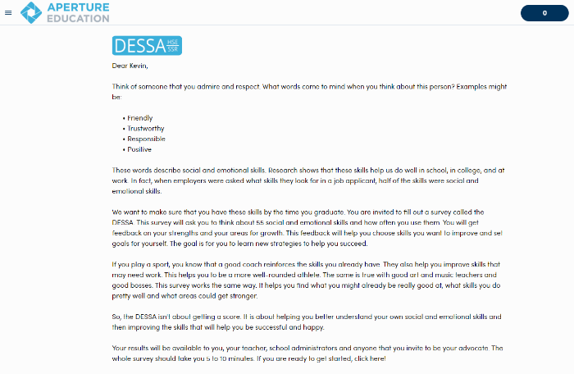
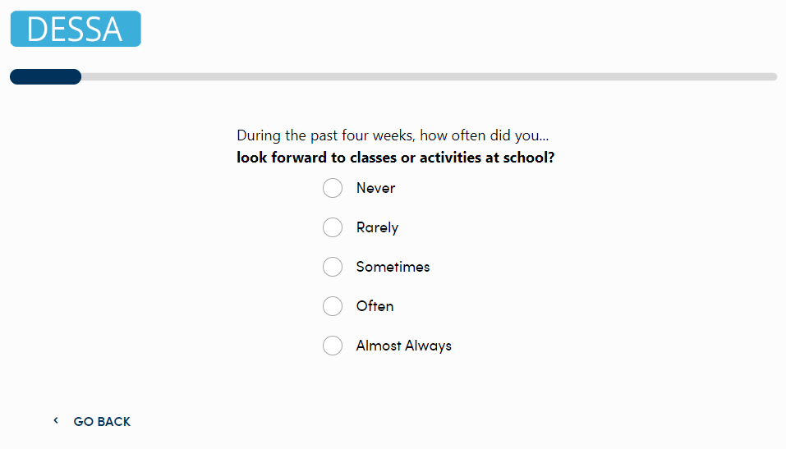
Completing the Student Self-Report
First:
Read the Welcome Letter about what the DESSA is and its purpose.
View the video and then click Begin at the bottom of the page.
Then:
Answer the DESSA SSR questions.
To return to a previous question, click Go Back at the bottom of the screen.
Next:
Keep building your strengths with suggested challenges and unlock a new badge and earn points with every challenge you complete.

Slide 14
After the Student Self-Report is Completed
Notes:
Note to the Educator:
This student-facing resource is designed to support the overall implementation of the DESSA Student Self-Report (SSR) for middle and high school grades.
It includes foundational information to share with students, embedded opportunities for student engagement, step-by-step directions for accessing the Student Portal features, and additional resources.
Suggestions:
Prior to facilitation, preview the slide deck and adjust it for your students, as needed. Connect with your site-based administrator for implementation details that can be shared with students.
Visit the Aperture Education Support Portal for more information and to submit a support request: https://selcompass.zendesk.com/hc/en-us

Slide 15
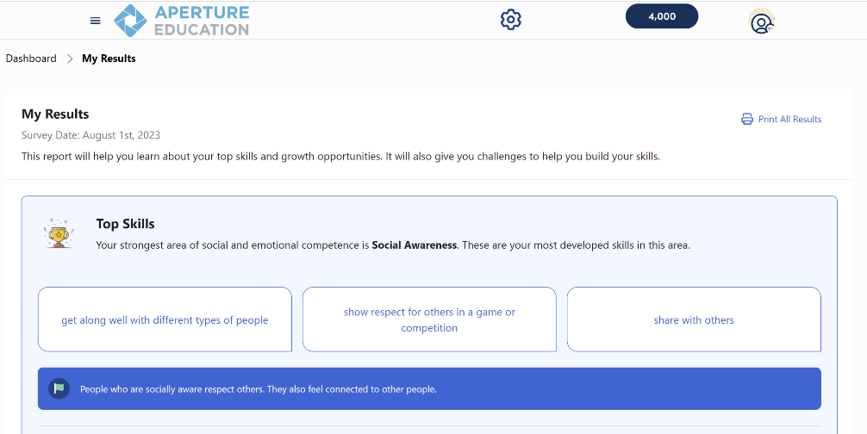
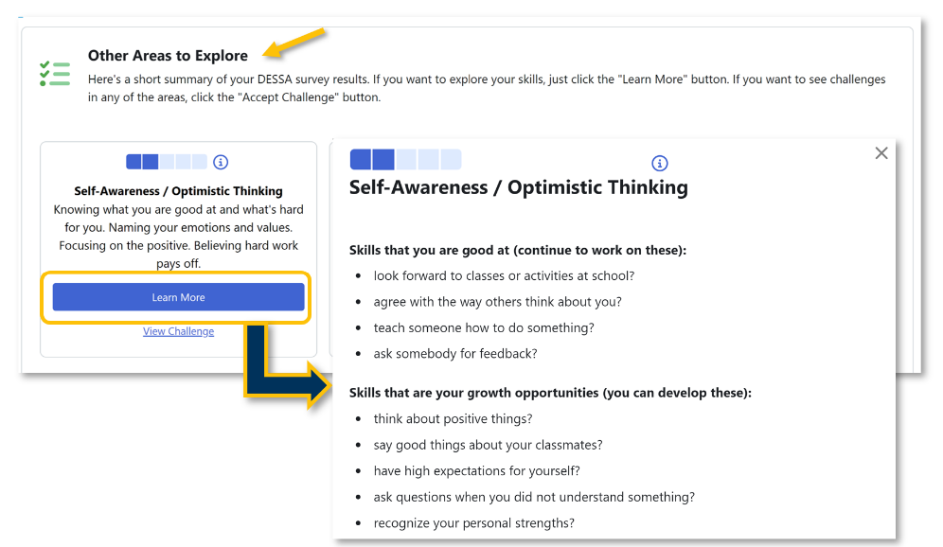
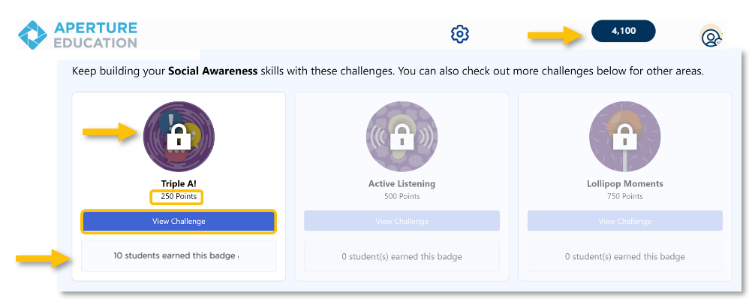
My Results
First:
Review your Top Skill
Then:
Scroll down to view results and learn more about each social and emotional competency (skill).
Next:
Keep building your strengths with suggested challenges.
Unlock a new badge and earn points with every challenge you complete.

Slide 16
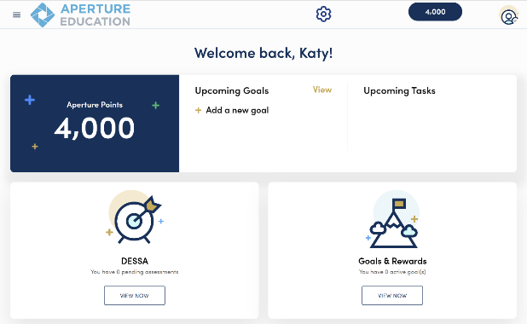
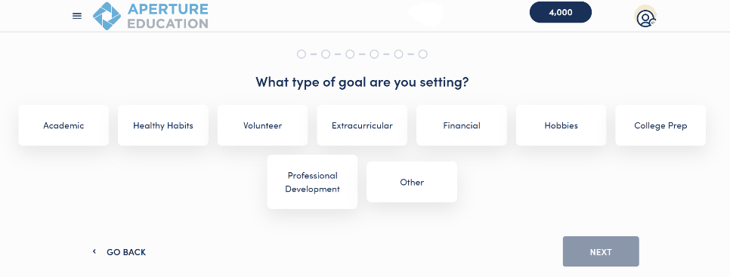
Set Personal SMART Goals
Select the “Goals & Rewards” section on the Dashboard.
Select “Add a new goal.”
Use the self-guided prompts to help create a personal goal that is relevant to you.
Earn points for submitting and completing your goals!
Notes:
Note to the Educator:
Remind students that they also have the option to set personal SMART goals within the Student Portal.
Students can access this feature by selecting the “Goals and Rewards” section of the dashboard and then selecting “Add a new goal.”

