Slide 1
Using DESSA Data Within the MTSS Framework
Notes:
Title: decision making, responding v. reacting
Script: Hello and welcome to Using DESSA Data within the MTSS Framework. The goal of today’s session is to equip you with a foundation for integrating DESSA data into the MTSS decision-making framework for the benefit of student performance.

Slide 2
Session Objectives
Understand how the MTSS framework impacts student outcomes.
Learn best practices for integrating DESSA data into the MTSS decision-making framework.
Establish procedures for monitoring student growth.
Notes:
In our time together,
You will gain a greater understanding of how the MTSS framework impacts student outcomes,
Use guided questions to contextualize how DESSA implementation supports MTSS as a decision-making process and learn best practices for integrating DESSA data into an MTSS framework.
And finally, we’ll discuss ways to help you monitor student growth.

Slide 3
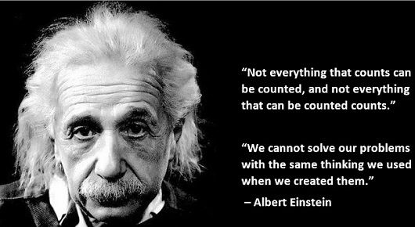
Reflect and Respond
Based on your current outcomes, how confident are you that your current decision-making process and the fidelity of this process is as effective as it could be?
Notes:
Understanding that the most valued resource in education is time, I want you to think about what you spend most of your time doing. I imagine it can sometimes feel like you spend most of your time making decisions, reacting to students, leaving very little bandwidth to respond thoughtfully to students and what’s happening with them.
More specifically, when thinking about supporting students socially and emotionally, this might mean we find ourselves reacting to student behavior, instead of using the data we have to support students proactively. And this goes for students who are thriving and doing very well, as well as students experiencing challenges.
Evaluating and refining our decision-making process helps us be more responsive to the needs of students, reducing the frequency of having to react. This shift does not happen haphazardly though, it takes intentional planning and reflection. Albert Einstein is quoted in saying [read quote].
With that in mind, let’s take time to reflect in the form of an anonymous poll. [CLICK]. Based on your current outcomes, how confident are you that your current decision-making process and the fidelity of this process is as effective as it could be? Let’s take a few minutes to do that now. LAUNCH POLL

Slide 4
Reflect and Respond
Introductions:
Name, State, Level, Role
Partner Discussion:
What is your greatest strength in your decision-making process?
What is your greatest barrier to effective decision-making?
Whole Group Share
Notes:
Now that we have some preliminary poll data, let’s delve a little deeper into what exactly might be preventing us from making decisions effectively.
In a moment, I will invite you to reflect on the following questions individually, and record your response on your workspace document: “What is your greatest strength in your decision-making process?” And “What is your greatest barrier to effective decision-making?”
The purpose of this exercise is to name our strengths and obstacles so that as we sojourn through this session, you are thinking of ways to leverage your strengths against the barrier(s) and implement the MTSS framework to fidelity. An added benefit of this engagement opportunity is to recognize that you’re not alone in this process.
I acknowledge the vulnerability it takes to share your barrier with someone else, but this learning experience is not about perfection, but more about meaningful connection that will drive lasting impact. Are we ready?
Let’s do this. We’ll take about 2 minutes for individual reflection and then I’ll open the breakout rooms.
Allow two minutes to elapse.
Alright, I am about to open our breakout rooms, but before I do I want to encourage you to introduce yourself using the information on the slide when you first get into the room, and then answer the questions from there. [Enter Intro Info into chat]
[Open breakout rooms- 2 participants per room- set timer for 4 minutes so at 5 minutes everyone comes back]
After breakout- Welcome back everyone! We’ll take 2 takeaways for our whole group share.
Awesome! Thanks so much for sharing. Let’s move into our first topic.

Slide 5
MTSS AND STUDENT OUTCOMES
INTEGRATING DESSA DATA INTO THE MTSS FRAMEWORK
MONITORING GROWTH
CLOSING
AGENDA
Notes:
MTSS and Student Outcomes. In this section, we’ll discuss how the MTSS decision-making framework impacts student outcomes in a general sense.

Slide 6
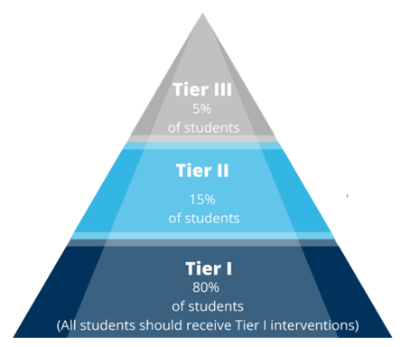
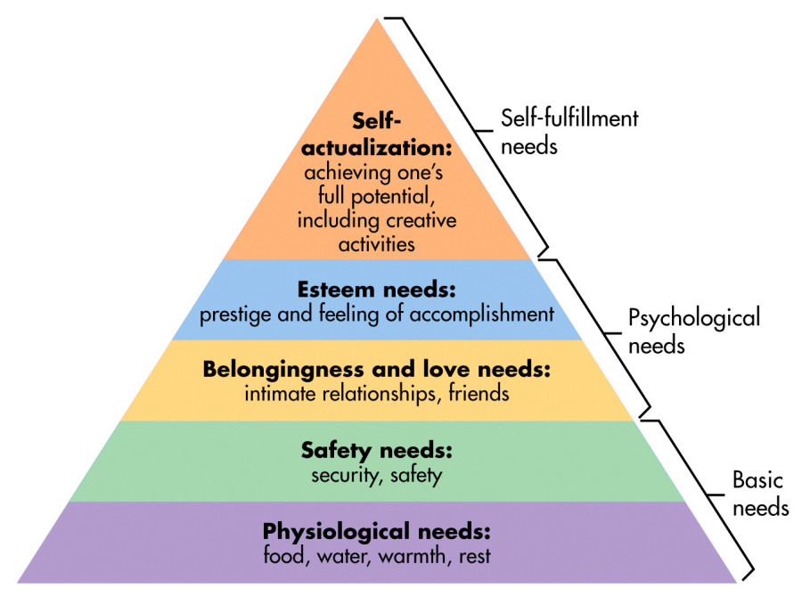
MTSS and Student Outcomes
Notes:
As many of you know, MTSS stands for Multi-Tiered Systems of Support, and even if your district doesn’t use MTSS, there are other variations of tiered support that intend to accomplish the same goal: Identify where students are and use data-driven systems and supports to get students where they need to be.
[CLICK] So, MTSS is a proactive decision-making framework comprised of three tiers, but it is based on a public health model. [CLICK] Universally, as educators and leaders we implement programs, practices, and systems that we hope will benefit students. From the social emotional lens, this means that we strive to meet students’ and teachers’ basic and psychological needs, including the need to feel competent in their social and emotional skills. This sounds like, “I am confident that I can do what’s being asked of me, and as a result I feel a great sense of accomplishment.” [CLICK again to disappear]
[CLICK] A productive MTSS model is one where leaders can make decisions to support students as they move up or down the triangle and is also one where the tiers build on one another.
Have you ever noticed during whole group instruction, that out of your 25 students about 19-20 are tracking with you, but there are always about 5 or 6 who you must consistently redirect, heavily engage, and directly support? Me too. And you know what that tells us? Tier 1 works for most students, but not everyone; so, a strong MTSS framework allows us to notice our scenario, understand the fact that redirection, engagement, and support in whole group is not sustainable, and make a decision to get those students the support they need before they experiences challenges or disruptions.
The ultimate goal of any MTSS framework is to notice when students require more support and give it to them. Monitor that it’s working to achieve the goal we set, and then fade those supports as students show success.
That said, let’s dig a little deeper into the fundamental elements that lay a strong foundation for a successful MTSS implementation.

Slide 7
MTSS and Student Outcomes
Safe & Predictable Environments
Build Relationships & Connectedness
Teach & Reinforce Social Emotional Skills
Components of Trauma-Informed Care, Substance Abuse for Mental Health Services Administration, 2014
Notes:
Setting a foundation for social emotional well-being means that you’ve attended to students’ basic, safety, and psychological needs. We do that through [Click] attending to the environment, creating predictable and consistent routines and procedures, by establishing schoolwide expectations and co-creating norms with students about how we agree to be with each other. This provides both physical and emotional safety.
[Click] We also intentionally build relationships to generally build a sense of community and connectedness, but also to create support networks for both kids and adults. We do this through a myriad of welcoming practices like greeting students at the door or using circles.
[Click] Finally, there has to be an intentional focus on building social emotional skills to support students’ social-emotional competence and self-efficacy, the belief in their ability to succeed academically, socially, and emotionally. This typically occurs through explicit social emotional instruction, intentional practice of skills, and generalization of skills between school and home.
Focusing on these universal components help to create a trauma-sensitive foundation of prevention and proactive response to meet the psychological needs that we all have.
Sometimes we can make the mistake of thinking we can focus on one or two components, but not all. These components are interrelated and work together to support adults and students holistically. Let’s dissect an example of safe and predictable environments.

Slide 8
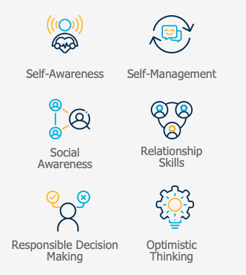
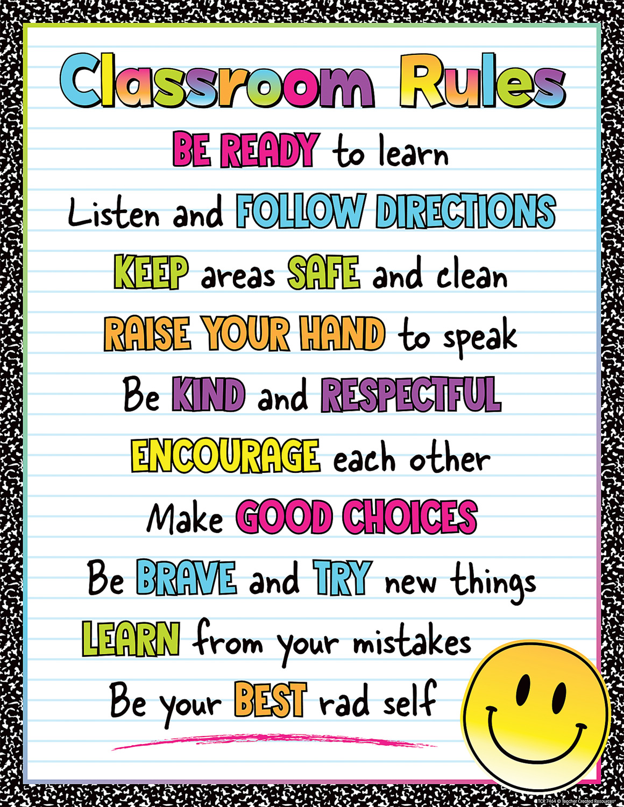
MTSS and Student Outcomes
Students need these skills
to demonstrate these behaviors
Notes:
One way to create safe and predictable environments is to establish schoolwide expectations. Schoolwide expectations contribute to safe and predictable environments by providing adults with a common language that gives students kind, specific, and helpful feedback about how they are doing demonstrating those expectations through a paired practice called pre-correction and behavior specific praise.
However, when I look at my classroom rules on the right side of the screen, what does, for example, “Be ready to learn” mean? Being ready to learn may require me to [Click] be able to identify my skill strengths and needs through self-awareness. [Click] It may require me to use my self-management skills to manage my task avoidance when we’re learning a skill that I’m not yet proficient in. [Click] It may require me to use my responsible decision-making skills to ask for support in a way that will elicit help from an adult versus getting me sent to the office.
When we approach social emotional skill-building or competence from a purely behavioral standpoint, we tend to over emphasize compliance to expectations, thereby creating a predictable environment, but missing the underlying cause for why students are not successfully meeting those expectations.
In essence, students need these skills[Click] to demonstrate these behaviors [Click]

Slide 9
MTSS AND STUDENT OUTCOMES
INTEGRATING DESSA DATA INTO THE MTSS FRAMEWORK
MONITORING GROWTH
CLOSING
AGENDA
Notes:
Makes sense right? But I bet now you’re wondering how we make an intentional effort to build social and emotional competence so that students demonstrate prosocial behavior. We do this by getting good data, beginning at the universal level.
As we’ve mentioned, MTSS is a data-driven decision-making framework to help educators make informed choices about how to support students.
How do we identify students at the universal level who need support? Yes, we have our observation and experience that those 5-6 students need more attention and support, but how can we capture that in a quantifiable metric that’s valid and reliable?

Slide 10
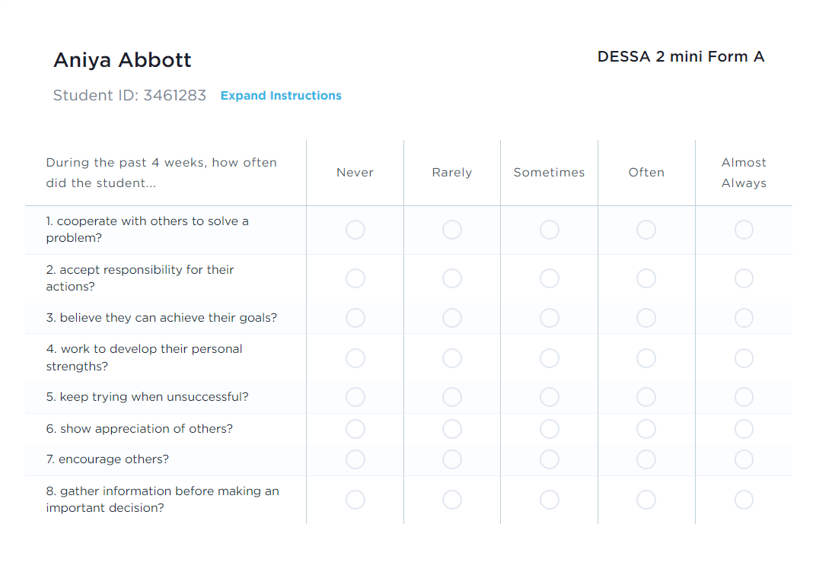
Is there a need?
What is the need?
What will we do?
Is it working?
Notes:
[CLICK]Well, in about 60 seconds, DESSA Mini data can predict whether an individual student needs more and that’s before they ever receive their first office referral.
Essentially, the DESSA mini as a universal screener begins in helping us answer these 4 questions: [CLICK] (1) Is there a need? [CLICK] (2) What is the need? [CLICK] (3) What will we do? And [CLICK] (4) Is it working?
At the Universal Tier 1 level, the DESSA mini tells us whether there is a need or not. Let’s look at an example.

Slide 11
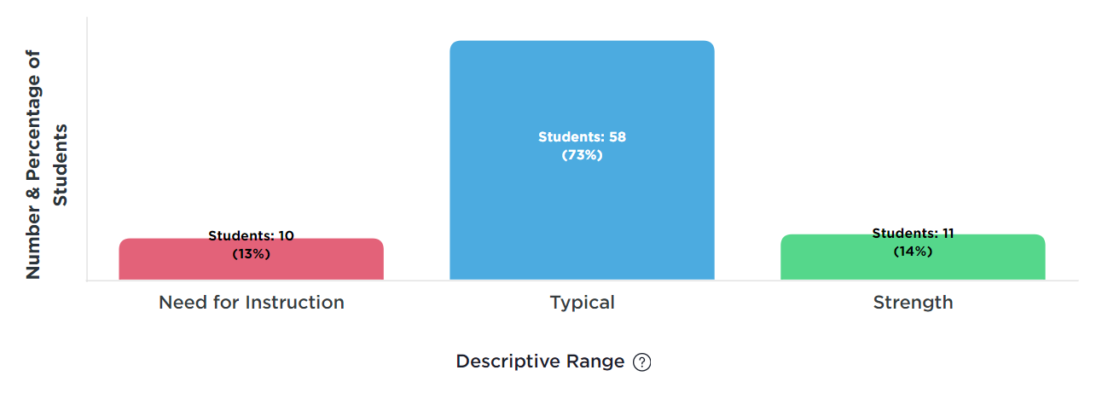
Tier 1 Example
Is there a need?
Notes:
It’s November at Rosehill Elementary, and we just finished our first rating using the DESSA mini. As a 4th grade team, we examine our data in our monthly grade level meeting to review and analyze our outcomes.
Based on our results, 13% of students are in the Need for Instruction range. This tells us that there is certainly a need, but not a severe one. Our data informs us that we’re doing very well with a combined 87% of our students performing in the Typical or Strength categories. This is something we can take the time to reflect on and be proud of while still asking ourselves some guiding questions.

Slide 12
Tier 1 Example
Is there a need?
What is working well at Tier 1? How do I know?
How do I know that universal practices are implemented with integrity?
How might this impact our outcomes?
Notes:
[READ QUESTIONS]
Now that we’ve read them, I’ll walk you through our answers and thought process.

Slide 13
Tier 1 Example
Is there a need?
What’s Working Well?
87% of students are in Typical or Strength
Foundational Practices
Transitions
Brain breaks
How do I know practices are implemented to fidelity?
Second step lessons are on pace
How does this impact outcomes?
83% of students are academically proficient.
Notes:
[MODEL] As we’ve acknowledged, based on the data, almost 90% of our students are performing in the Typical and Strength descriptive ranges.
[CLICK] So, what’s working well? Most of our students demonstrate a typical manifestation or strength in the competencies they are being evaluated on. In our KidTalk time as a team, we celebrate the fact that as a result of the Foundational Practices, our transitions in the morning from breakfast to the classroom are smooth, our transitions between subjects are seamless, and for the most part we only have to redirect those 10 students on a consistent basis.
Moreover, during Brain Breaks which are relatively unstructured academic reprieves, all of our students enjoy getting the wiggles out and successfully engage in competencies like social awareness, responsible decision making, and relationship skills.
[CLICK] Our morning meeting time is reserved for direct instruction using Second Step, so because we’re on pace with those lessons, we’re certain that Universal practices are being used to fidelity.
[CLICK] From an academic lens, the My Students report aligns well to our last benchmark, whereas about 83% of our students are performing proficiently in Reading and Math. So Universal practices have impacted these outcomes because our students are not only ready to learn but demonstrating that they have retained and applied their learning.

Slide 14
Reflection: Universal Practices
What is working well at Tier 1?
How do I know?
How do I know that universal practices are implemented with integrity?
How might this impact our outcomes?
Notes:
Having said that, I invite you follow the model of our 4th grade team at Rosehill elementary and reflect on your DESSA mini implementation and data using the guiding questions provided. Let’s take about 5 minutes to do this on our workspace document.

Slide 15
Tier 2
Tier 2 Interventions are:
Easily & quickly accessible
Aligned and layered on universal practices
Data-driven for early intervening
Notes:
So, we’ve seen that reliable social-emotional data at the Tier 1/Universal level will help us quickly determine our impact from an aerial view, but it will also tell us who needs additional support.
If a group of students need Tier 2 supports layered on top of universal supports, how do we know what type of intervention is needed and how do we access interventions that are easy to use and aligned to the universal practices?
Well, the DESSA is a follow-up assessment used to dig deeper into the specific need a student or group of students has. By completing a full DESSA after the DESSA mini, educators will know what the specific need is and can then determine the appropriate interventions.
Let’s head back to Rosehill Elementary and check on those 10 students in the Need for Instruction range.

Slide 16
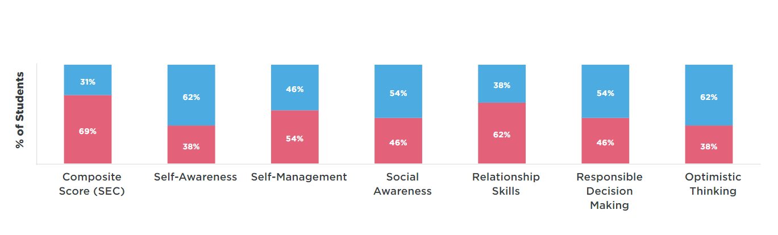
Tier 2 Example
Is there a need?
What is the need?
Notes:
Here’s the Competencies report which is a breakdown of how those 10 students performed in each competency after receiving a full DESSA. The DESSA mini, given to our entire grade level showed us that there was a need [CLICK], the full DESSA, completed on those 10 students in the grade level, shows us what the need is [CLICK].
According to our breakdown, our 4th grade students at Rosehill who received a full DESSA are Self-Awareness Superstars and great Optimistic Thinkers! [CLICK]. Although they scored in the Need for Instruction range overall, they scored higher in the Typical (blue) range in those areas. They’re also fairing rather well in Social Awareness, and Responsible Decision Making where they scored 54% in the Typical and 46% in the Need for Instruction range. So, let’s pause to note, that although these students are showing a need, they still have relative strengths that warrant celebration.
However, there are two competencies that our friends are struggling with. In a moment, when I say “Go”, flood the chat with the two competencies in which our 4th graders are showing the greatest need.

Slide 17
Tier 2 Example
Is there a need?
What is the need?
Notes:
Awesome! You’re absolutely right. Self-Management and Relationship Skills are the two areas that show the greatest need. But that’s what our DESSA data shows.
I want you to take a moment and think to yourself “What other data points can we use to inform our next steps?”
For example, self-management and relationship skills are both interpersonal skills. What other measures do we use to capture student’s competencies in those areas?
Maybe PBIS, right? Maybe we review our PBIS data because it measures interpersonal skills, and we can see if any of these students have referrals on the playground, cafeteria, hallway, or other areas that are highly interpersonal.
Now it’s your turn! We’ve examined Tier 1 data, and you now know whether there’s a need. Now, use the Competencies report to determine what the need is.

Slide 18
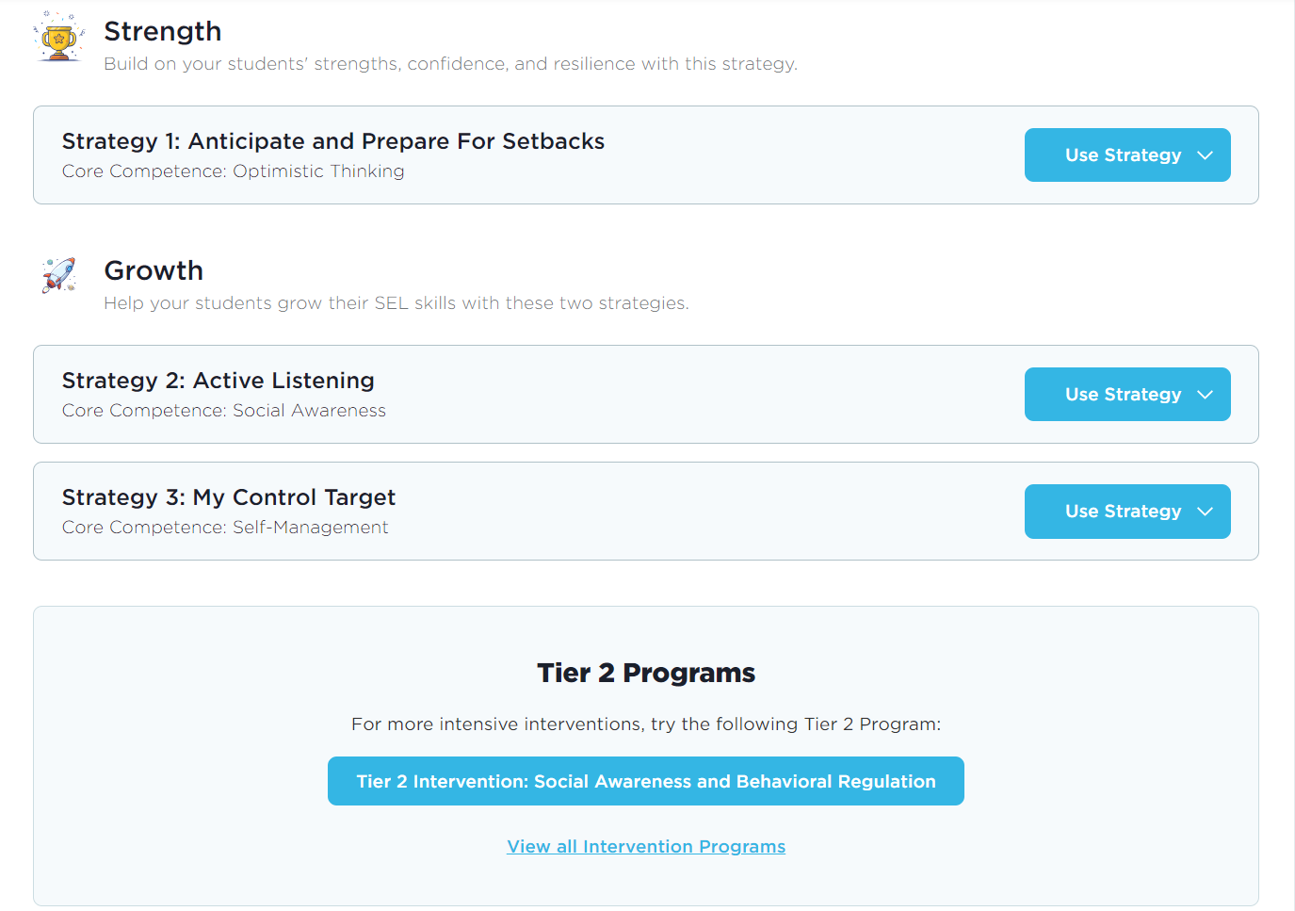
Tier 2 Example
Is there a need?
What is the need?
What will we do?
Notes:
If you weren’t sure which number to select based on the data, fear not! Our Data-Driven Recommendations is another tool that helps us align the DESSA into the MTSS decision-making framework to help teachers, help students.
And, it even tells us what we can do about the need we have.
So, once we’ve given our universal screener at Rosehill, [CLICK] and we know which students need support and the kind of the support they need, [CLICK] we can now act on that support.
As you see here, just like our competency report showed us, [CLICK] Optimistic Thinking is a relative strength of our 4th grade students in the Need, but they really need help with [CLICK] Social Awareness and Self Management. What can I do to help them?
I can place them in one group of 10 or break them into 2 smaller groups of 5 and I can use the recommended strategies in tandem with the [CLICK] recommended Tier 2 intervention.
But what if 1 of those 10 students needs more?

Slide 19
Is there a need?
What is the need?
What will we do?
Tier 3 Interventions are:
Intensified
Individualized
Aligned with Tiers 1 & 2
Data-driven
Notes:
When we reach Tier 3, we are oftentimes working with students who have already demonstrated risk indicators and are using unproductive responses that are getting them into trouble academically and/or socially-emotionally.
However, a well-functioning MTSS framework means that for Tier 3 support, we really should only be planning for about 5% or less of our student population. For that to happen, we need to ensure that our universal practices and our Tier 2 supports are implemented with integrity such that our educators feel confident and competent in implementing those practices and those practices are monitored for impact.
When our Universal and Tier 2 supports are layered effectively within that data-driven decision-making framework, it empowers educators and student support teams to confidently provide Tier 3 supports that will be individualized based on that student’s needs and will be aligned to the Tier 1 and Tier 2 supports that are already in place.
With that in mind, let’s walk down the road of Tier 3 support with my favorite student: Joel Charity.

Slide 20
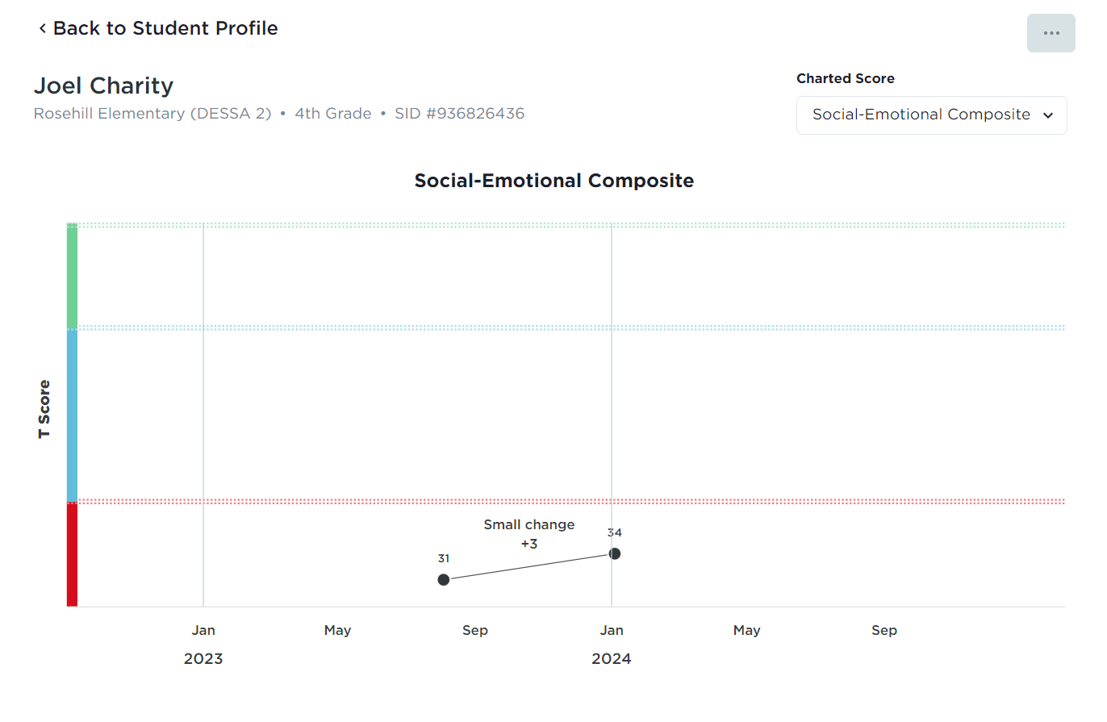
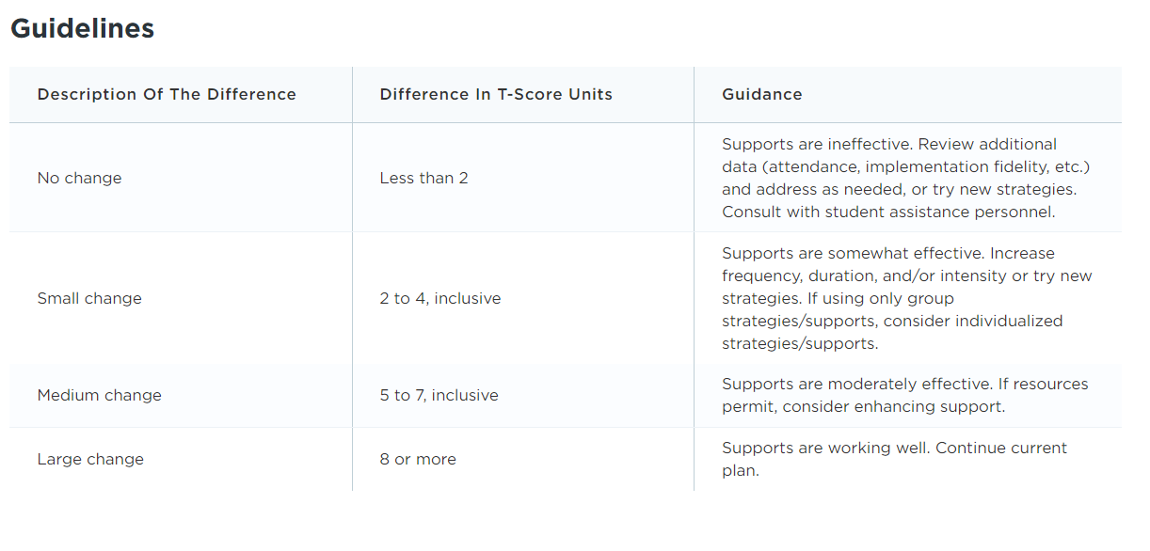
Tier 3 Example
Notes:
Joel was one of those 10 4th graders at Rosehill whose data told us she would benefit from Universal instruction and Tier 2 intervention. In our first rating window, we administered a DESSA mini, which told us that there was a need. We then completed a full DESSA, which told us what the need was and how to address the need.
However, as we see here, between that first rating window and the mid-rating window, [CLICK] there was a small change in Joel’s growth.
So now with this information and roughly five months left in the school year, we know that we need to [CLICK] intensify and individualize support for Joel. But how?

Slide 21
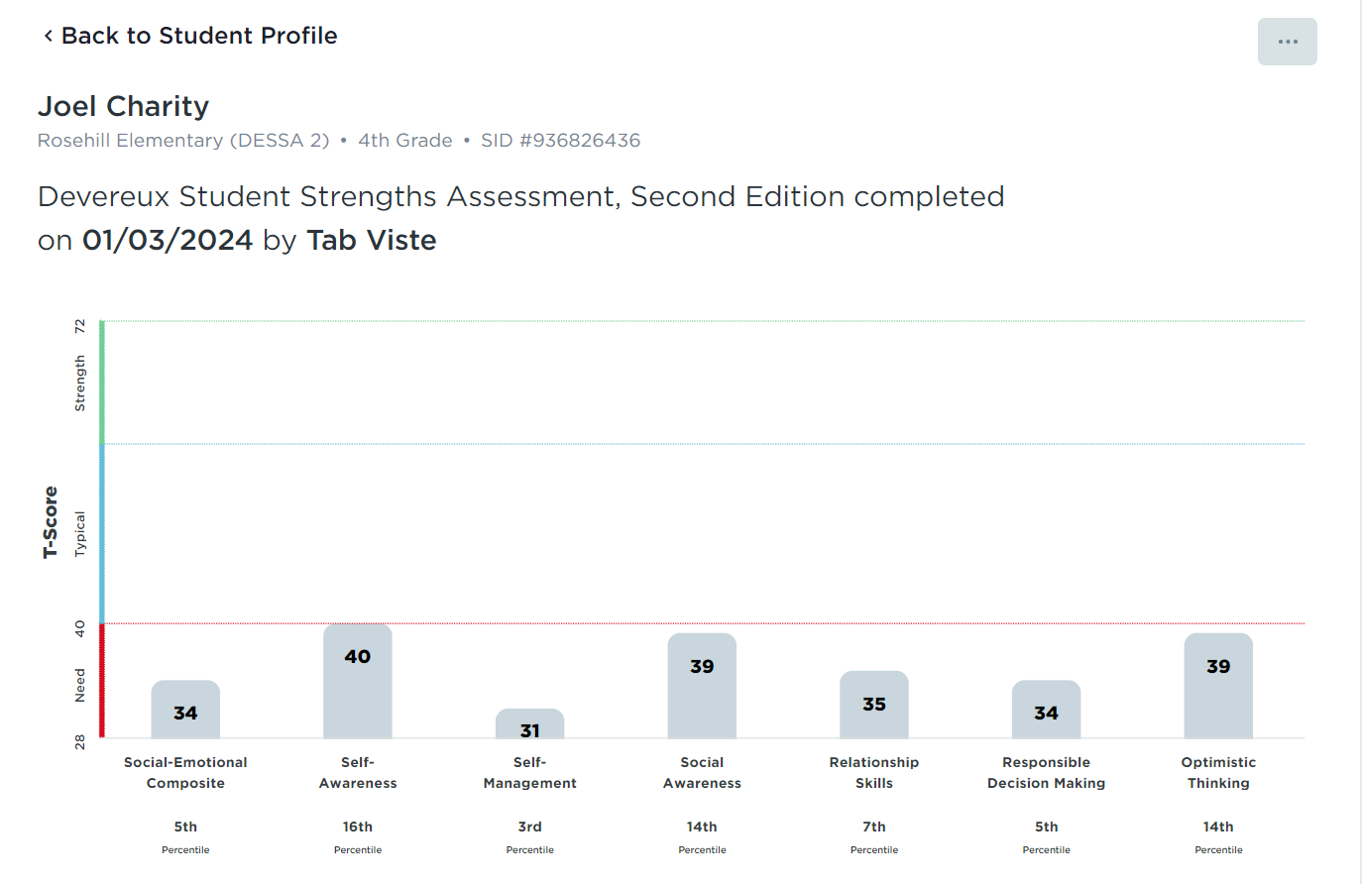
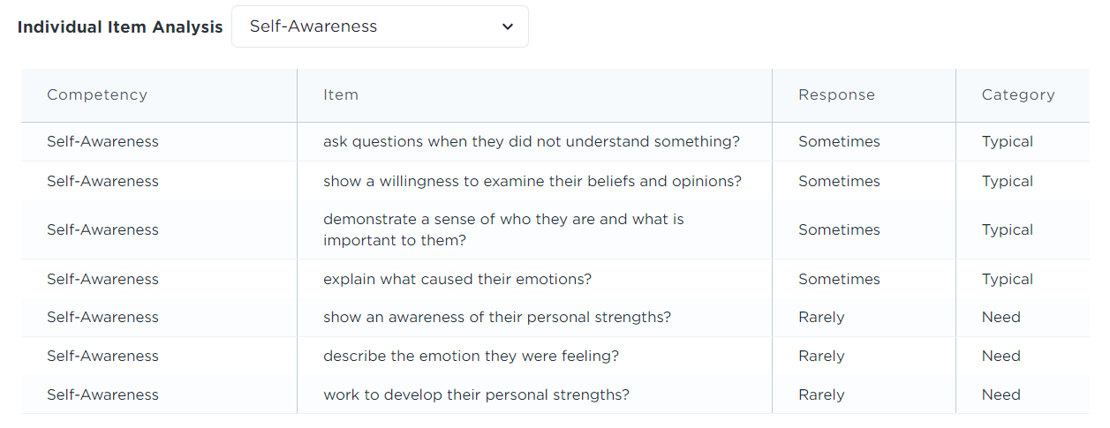
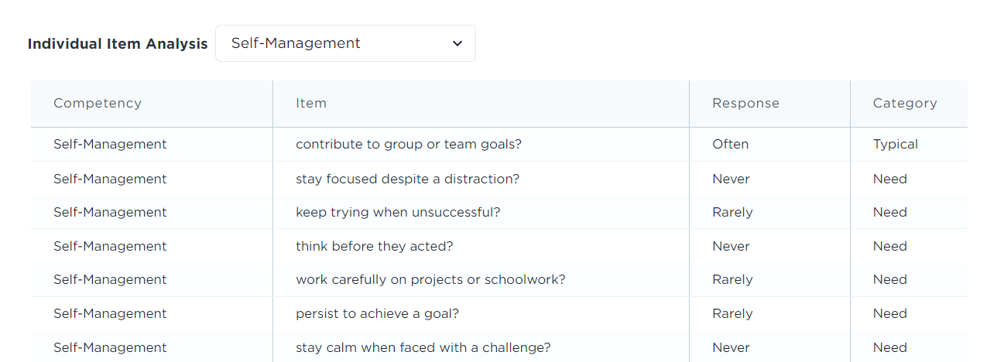
Tier 3 Example
Strength
Need
Notes:
Let’s look at Joel’s most recent rating. My colleague Mrs. Fanning is Brodie’s teacher and according to her rating, Joel has a relative strength in Self-Awareness[CLICK], which the item analysis tells us means that she sometimes demonstrates a sense of who she is and what is important to her and can sometimes explain what caused her emotions.
On the other hand, though, [CLICK] Joel really struggles with Self-Management where she never stays focused despite a distraction or thinks before she acts .
So, beginning with her relative strength, we don’t have to guess about how we can help Joel. We know that we can continue building her Self-Awareness and that will in turn transform her mental model about Self-Management.
This goes back to our pyramid of safety we discussed earlier. When I know I can do what is being asked of me, I am more likely to feel a sense of accomplishment and demonstrate prosocial behaviors like “being ready to learn”.
Engaging Joel in a way that compels her to slow herself down, think about her triggers and what causes her to react without thinking can help her improve her self-management.
As an example, this could sound like behavior specific praise where it’s modeled for her how to stop and think before acting. When Joel raises his hand to answer a question instead of yelling out an answer, Mrs. Fanning could say, “Thank you for raising your hand, Joel! Go ahead and share your answer with us.”
Or if Mrs. Fanning notices that Joel stayed focused on a task despite a class being rowdy in the hallway, she could immediately commend her for that.

Slide 22
The Power of Strengths-Based Support
Strengths-Based Approach | Deficit-Based Approach
Fosters students’ mindset of growth and resilience Promotes student well-being, self-esteem, and self-confidence Proactive upstream approach Supports mental health promotion and prevention efforts | Fosters students’ mindsets of low expectations and helplessness Focuses on behavioral concerns Reactive downstream approach Lagging indicators reliant on elevated behavioral concerns
(Aperture Education, 2024)
Notes:
Supporting social emotional well-being from a strengths-based lens at all tiers allows us to more productively partner with students and reinforce the power of yet. It allows us to get ahead of difficulties that students may be having and proactively address needs before they escalate and worsen.
We can then proactively practice more productive and positive responses to challenging situations, creating a resiliency effect that will support positive mental health as students age.
Citation: Aperture Education. (2024). Guidance on using the DESSA-mini and DESSA in the process of mental health screening and assessment [White paper]. Aperture Education. Guidance-on-Mental-Health-and-Social-Emotional-Screening.pdf (apertureed.com)

Slide 23

Think-Pair-Share
How might a strength-based approach improve:
Conversations about student support?
Culture and climate?
Engagement with families?
Notes:
Let’s take a moment to reflect on the strength-based approach and how that might improve conversations, culture, climate, and engagement.
Take about 3 minutes to record your reflections on your workspace document and then I will put you in your breakout rooms and give you a chance to chat (7 mins).

Slide 24
MTSS AND STUDENT OUTCOMES
INTEGRATING DESSA DATA INTO THE MTSS FRAMEWORK
MONITORING GROWTH
CLOSING
AGENDA
Notes:
Now that we know what to do for our students, let’s figure out how we can monitor the progress of our decisions to determine how effective they’ve been.

Slide 25
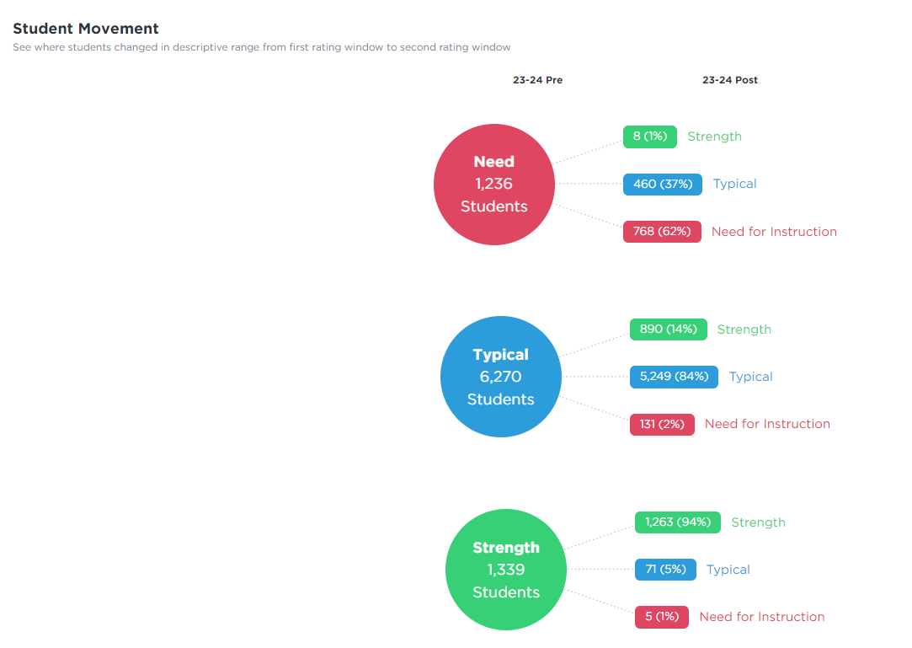
Monitoring Growth
Is it working?
The Impact Report allows you to compare the progress from one rating to the next.
The DESSA and DESSA Mini allow for progress monitoring throughout the year.
Notes:
Social emotional competence is a bit challenging to progress monitor because it’s multi-faceted. And we often don’t provide instruction in social-emotional skill growth as frequently as we do academic instruction. So social-emotional skill growth takes time. However, we can use the DESSA to measure growth in multiple ways.
At the Tier 1 level, the Impact Report is an exceptional means of viewing data on student progress from rating window to rating window. This is also a great way to monitor if students have dropped in their social emotional competence, which could indicate that more is happening with that student beyond the surface.
At Tier 2, you can use the Competencies Report to monitor the progress of small group intervention, and at Tier 3, you can use the Individual Student Profile to review student progress from a longitudinal lens.
Outside of reports, you can use the DESSA Mini and its 4 alternative forms throughout the school year to progress monitor at the Tier 1 level, and the full DESSA for students in Tiers 2 and 3.

Slide 26
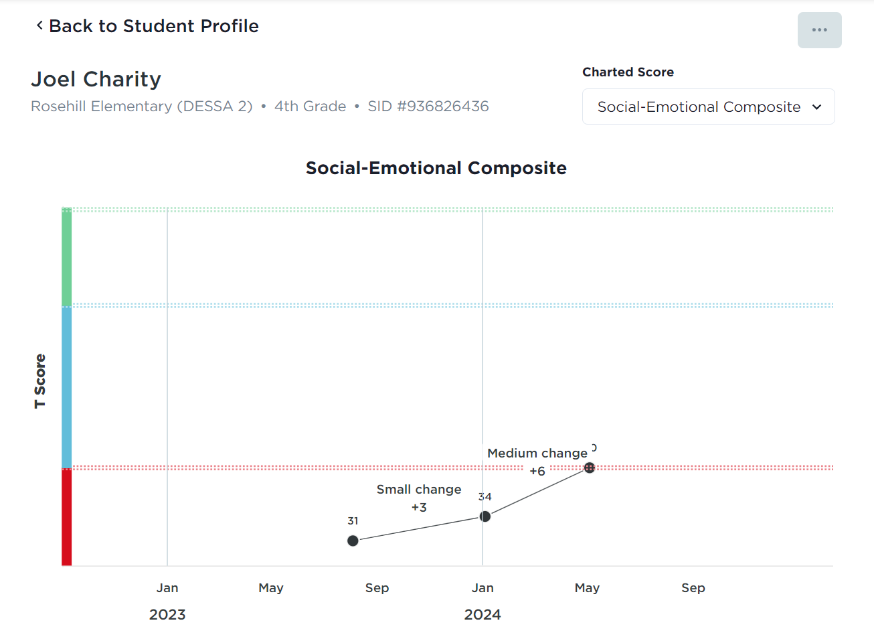
Monitoring Growth
Is it working?
6 T-Score Points = Medium Change
Notes:
Here is one example of longitudinal data and how we can use this data to monitor the progress of students.
As you can see, this student has made significant progress in their Social Emotional Composite but look at how they’ve grown in competencies like Optimistic Thinking and Relationship Skills!
This just goes to show that the day you plant the seed is not the day you eat the fruit. If we create a plan and stick to it though, positive outcomes are inevitable. Imagine this student on graduation day!
​How might using data like this support your work with students, educators, and families?
Let’s use about 3 minutes to record our answers on our workspace document, and then we’ll share out with the group.

Slide 27
MTSS AND STUDENT OUTCOMES
INTEGRATING DESSA DATA INTO THE MTSS FRAMEWORK
SUSTAINING YOUR IMPLEMENTATION
CLOSING
AGENDA

Slide 28
In Summary . . .
Set a foundation for social and emotional well being by cultivating safe and predictable environments.
Integrate the DESSA into the MTSS decision-making framework by:
Determining if there is a need.
Naming the need.
Creating a plan to address the need.
Monitoring the effectiveness of the plan.
Celebrating success along the way.
Implement and reflect on fidelity and impact of practices at all levels.
Notes:
Throughout our time today, we took time to identify what advanced tiers should look like most effectively.
We explored the benefits of starting with a strengths-based lens for support.
We also experienced using good data to support strong decision making through a problem-solving cycle
And, in summary, in order to streamline our MTSS framework and ensure that we are being more responsive than reactive, we need to:
[Click] Set a foundation for social and emotional well being by cultivating safe and predictable environments.
[Click] Integrate the DESSA into the MTSS decision-making framework by:
Determining If there is a need.
Naming the need.
Creating a plan to address the need.
Monitoring the effectiveness of the plan.
Celebrating success along the way.
And [Click] Implement and reflect on fidelity and impact of practices at all levels.
All this to ensure that we maximize our precious and scarce resources: time, money, and, and most importantly, people.

Slide 29

Optimistic Closure
Based on your takeaways, what is one thing you can do right now to improve your integration of DESSA data into your data-driven decision-making process?
Notes:
We’ve now come to our final reflection. For our optimistic closure today, I want you to think about your gleanings from today’s session.
Based on your takeaways, what is one thing you can do right now to improve your integration of DESSA data into your data-driven decision-making process?
I invite you to record your final takeaways on your workspace document and feel free to add them to the chat if you so desire. (2 mins)

