Slide 1
Getting Started with the DESSA System

Slide 2
Session Objectives
Identify key components of the DESSA assessments in order to support educators with implementation.
Learn best practices for completing ratings and interpreting the scoring result categories.
Explore features of the Educator Portal.
Notes:
In our time together, you will
Identify key components of the DESSA assessments in order to support educators with implementation.
Learn best practices for completing ratings and interpreting the scoring result categories, and
Explore features of the Educator Portal.

Slide 3
Opening Activity
In the chat…
What hopes do you have for your school community this year?
Notes:
As an opening activity, before dive right into content, we want to hear from you. When we open a training with hope, it centers us on our “why” and helps us frame our work accordingly. So, in the chat, please share your hopes for your school community this year.

Slide 4
WHAT IS THE DESSA?
HOW TO COMPLETE RATINGS
THE EDUCATOR PORTAL
IMPLEMENTATION OVERVIEW
OPTIMISTIC CLOSURE
AGENDA
Notes:
Thank you so much for sharing! Let’s talk through how we’ll spend the rest of our time together.
We’ll discuss what the DESSA is and what it is not,
We’ll practice completing a rating,
We’ll walk through an overview of the Educator Portal and the roles within it,
And finally we’ll close out with an optimistic closure and opportunity for feedback.

Slide 5
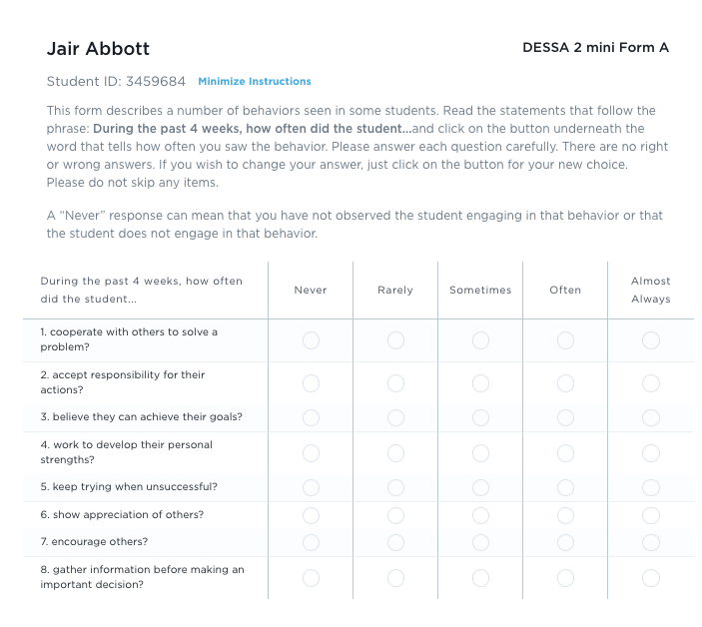
What is the DESSA?
An evidence-based social and emotional competency assessment to support student growth.
Notes:
From our opening poll, it looks likes… (recap the group’s familiarity with the assessments here based on the previous poll answers).
In this session, we will dive into what the DESSA assessments are and how they can be used to support educators, students, and their families.
(Click) In short, the DESSA is an evidence-based social and emotional competency assessment to support student growth, including a screening tool and a full diagnostic assessment that educators complete for their assigned students.

Slide 6
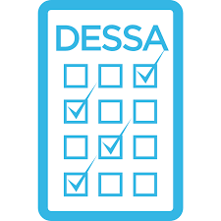
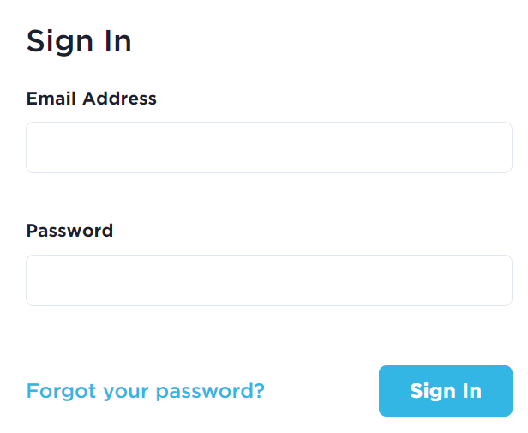
DESSA: The Basics
DESSA
2024-2025
Strength-based behavior rating scale, K-12 editions
Educator Portal:
DESSA ratings & data reports, resources, support
CASEL-aligned
Site-based implementation schedule
Notes:
In a moment, we will dive into details further. As an overview:
(Click) The DESSA is directly aligned with the CASEL framework for social and emotional learning (SEL)
(Click) It is a nationally standardized, strength-based behavior rating scale that assesses students’ social and emotional competence with editions that support students K-12.
(Click) It has been used by districts and out-of-school time programs across the country, and site or district-based implementation schedules are outlined for this data collection
(Click) Finally, DESSA assessments and real-time data reports are located in the online Aperture System, along with additional resources, and support options.

Slide 7
Why Measure Social and Emotional Growth?
To Drive Meaningful Change and Evaluate Outcomes
Systems
Climate
Practice
Notes:
Slide Purpose: To set up the overview of why educators are using the DESSA
Talking points:
The second question we ask upfront here is “why measure student social and emotional growth?” and for that, there are many answers that we will address throughout this session as we look at the components of “how” to collect this data.
A quality social and emotional assessment is an important part of any SEL program implementation and can help to drive meaningful change and evaluate outcomes in a school, district, or program. (language pulled from Aperture website)
We ALSO refer to CASEL again, as they outline the importance of practicing continuous improvement by establishing an ongoing process to collect, reflect on, and use implementation and outcome data to inform decisions and drive improvements to SEL programming.
Use the DESSA to inform data-driven next steps for [CLICK] systems [CLICK] climate, and [CLICK] practice.

Slide 8
Measuring Student Growth: The Basics
Identify
Be Proactive
Connect
Inform
DESSA
Notes:
Slide Purpose: To share an overview of why educators use the DESSA to measure student growth before diving into details
Talking points:
The DESSA was designed to:
Provide a psychometrically sound measure of social-emotional competence in children and youth by identifying the unique strengths and needs of students
The DESSA screening tool proactively identifies students who may be considered “at-risk” in different areas
The data collected from the DESSA can be used to inform tiered instruction and intervention, and measure the results of SEL programming
Finally, using the DESSA to measure student growth provides a common lens and language for crafting an SEL program that connects educators, families, and students.

Slide 9
Group Share
How can measuring students’ social and emotional competence be of value to your role?
Notes:
Before we move forward into more detail about the DESSA assessments, let’s pause here together and do a quick group check-in in the form of reflection.
In a moment, I’ll invite you to reflect and enter a response into the chat. (Facilitation option: breakout rooms, verbal share)
To check-in with ourselves and the information that has been shared so far, I invite you to reflect on:
(Click) How can measuring student social and emotional competence be of value to your role as a school leader?
Perhaps you will utilize the data collected within your specific role or you will be supporting educators in their process of collecting and using the data to inform their decisions, or maybe you are not sure what your role in the process will be quite yet (that’s okay!)
For now, what benefits to collecting this data about students’ strengths in social and emotional strengths do you forsee, based on your experience and expertise?
(Facilitation Notes: Allow enough “think” time for attendees to think of their answer, and to enter a response in the chat, and/or share verbally. After attendees have had time to think and enter a response, acknowledge a few that stand out to you as the facilitator and comment or highlight. Thank attendees for sharing before moving on.)
(Additional Facilitation Options: Breakout Rooms, Verbal Share. If facilitating this for a custom session, where staff already know each other, could provide the option to use breakout rooms or for staff to volunteer their responses by coming off mute).

Slide 10
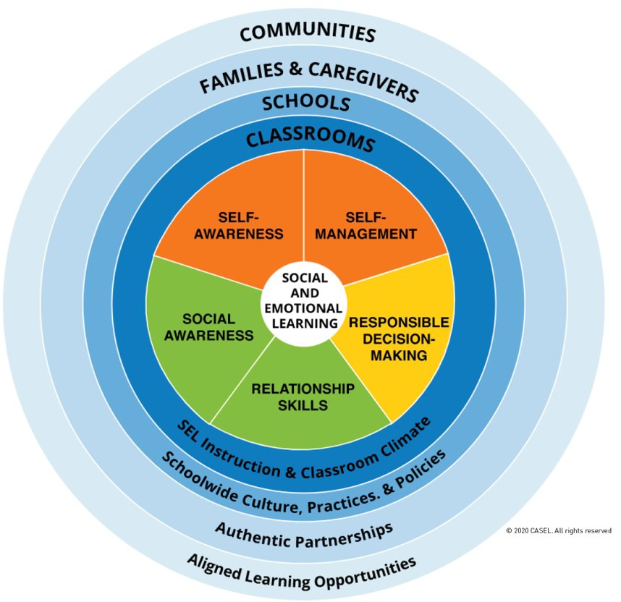
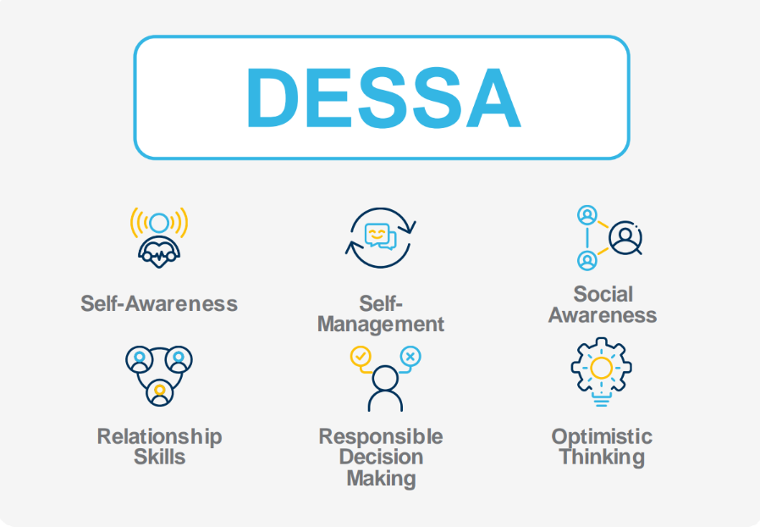
CASEL & DESSA Alignment
Notes:
Slide Purpose: To align background SEL/CASEL information with
Talking points:
As we’ve mentioned, CASEL, or the Collaborative for Academic, Social, and Emotional Learning, provides the foundational framework for social and emotional learning (SEL), including 5 core competency areas that we see here in the center of the circle (Facilitator option: trainer can read off these skill areas, if desired/if the group is newer to SEL)
Within the outer rings, the environments in which these skills can be taught, practiced, and cultivated are labeled.
Within the first two inner rings, starting within the classroom, the focus is on SEL instruction and climate, and across the school campus, the focus is on the culture, practices, and policies.
In the outer two rings, students’ families and caregivers, as well as community partners, are encouraged to be involved in this learning process through authentic partnerships and identifying aligned learning opportunities.
(Click)The DESSA assessments measure behaviors in each of these CASEL aligned areas, as well Optimistic Thinking.

Slide 11
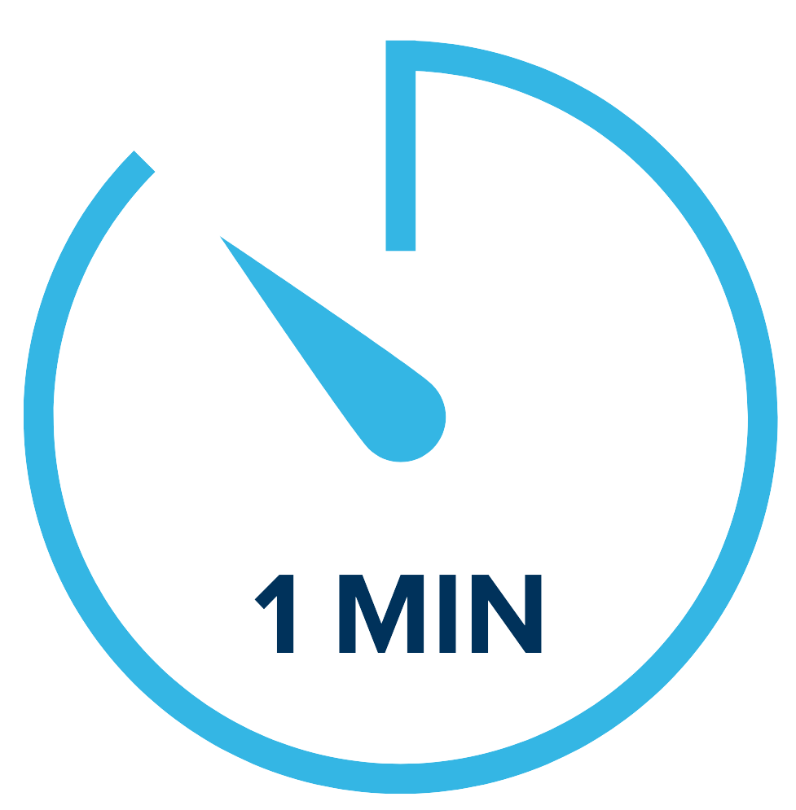
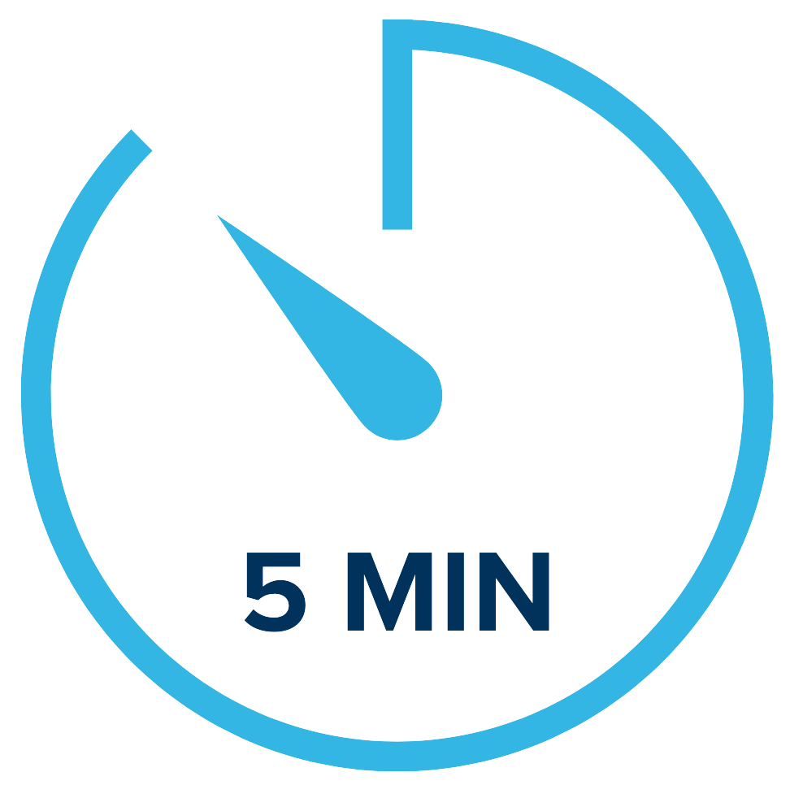
DESSA Assessments
Standardized
Norm-Referenced
Strength-Based
K-12th Educators Complete
DESSA-Mini Universal Screener
DESSA Assessment
Notes:
On the bottom portion of this slide, the different DESSA assessments are noted, which we will expand on in just a moment.
First, let’s take a look at the development and standardization properties of the DESSA assessments.
(Click) All the DESSA assessments are standardized; there are established procedures for administering, scoring, and interpreting the results.​ The standardization sample was representative of the population across the United States and a bias analysis was completed for each question item.
(Click) They are norm-referenced scores and are based on a national sample of students. Students’ social and emotional competence can be compared or benchmarked to other students. ​The assessments are classified as Behavior Rating Scales which are one of the most common forms of assessment used in the educational field.
(Click) Most uniquely, the DESSA assessments are strength-based. Every question on the DESSA is a positively worded, desirable behavior, such as “get along with others”, rather than maladaptive ones, like “annoys others”. There are many advantages to this approach of promoting social and emotional competencies, a main benefit is that these social-emotional competencies contribute to a student’s resilience in the face of adversity. By highlighting students’ strengths, educators can help students leverage their strengths in areas of growth.

Slide 12
DESSA 2 mini
K-8
Score:
Social-Emotional Total (SET)
Universal Screener
4 Forms
Educators Complete
Notes:
Slide Purpose: Provide a more detailed explanation of the DESSA-mini assessment properties
Talking points:
The DESSA-mini is a universal screener of social and emotional competence designed for all students. It has 8 questions and takes about 1 minute per student for an educator (or rater) to complete.
The primary purpose of the “mini” screener is to quickly and accurately identify which students may be at risk of academic and behavioral difficulties based on their social and emotional development.
The screener is completed online after at least 4 weeks, or a cumulative of 24 hours over a 4 week period of interaction and observation of the student. There are 4 different forms that can be utilized for progress monitoring throughout the school year.
(Click) The results from the DESSA-mini produce a Social-Emotional Total (SET) score that provides an indication of a student’s overall social and emotional competence at the time of assessment.
This data can help educators plan how best to strengthen, readjust, or add universal supports. This screener can also help to identify students that may benefit from additional assessment.
(Click) A few examples of questions that are on the DESSA-mini are listed here, with the answer options that can be selected based on the frequency in which the educator has observed the student to utilize a specific skill.
(Facilitation options: Pause momentarily to allow participants time to read or read aloud the questions/answer options that are listed on screen)
Facilitator FYI- There are 8 questions on DESSA-mini K-8

Slide 13
DESSA-HSE mini
9th-12th
Universal Screener
4 Forms
Score:
Social-Emotional Total (SET)
Educators Complete
Notes:
It’s important to note that for the high school setting, educators complete a version of the screener called the High School Edition, or the DESSA-HSE mini.
Similar to the screener used for grades Kindergarten through 8th grade, educators complete the screening, which also results in one score, the Social and Emotional Total (SET).
(Click) There are differences in the language used on the high school edition (the HSE), including “youth” instead of child, and the frequency scale options for the educator to select from when answering the questions. The skills assessed on the HSE screener also reflect that of students within the 9th-12th grade range.
(Facilitation options: Pause momentarily to allow participants time to read or read aloud the questions/answer options)
Facilitator FYI- There are 8 questions on DESSA-HSE mini

Slide 14
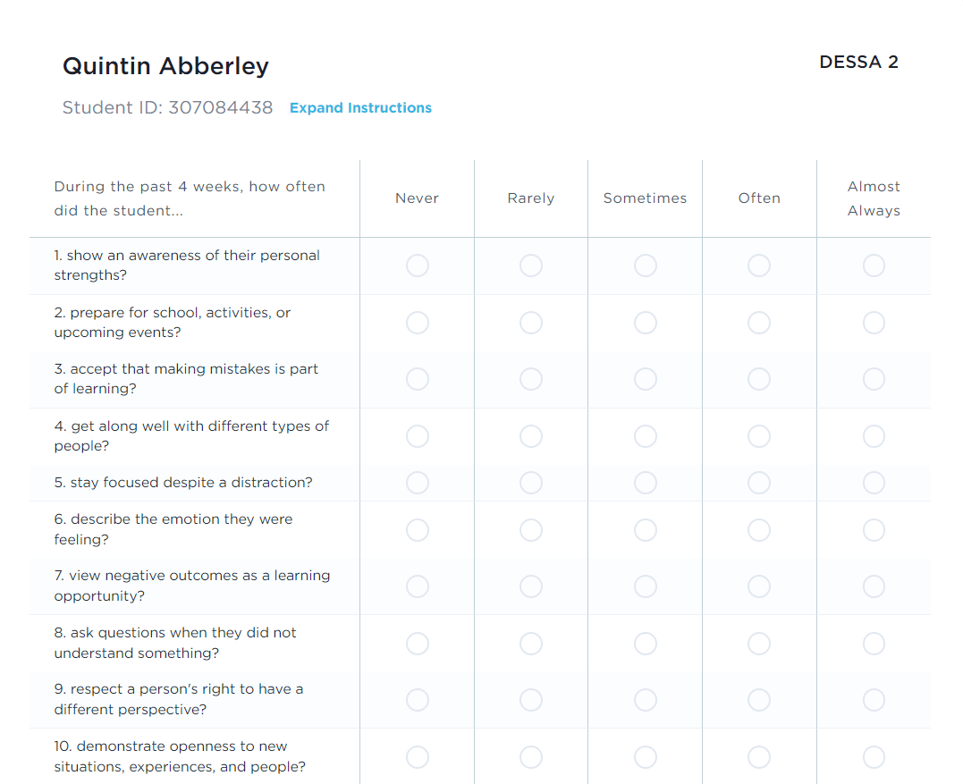
DESSA 2
K-8
Assessment of 6 competency areas
Educators Complete
Scores:
Social and Emotional Composite (SEC)
6 competency areas
Notes:
The DESSA is a full assessment of students' social and emotional competencies. It takes about 5 minutes for an educator to complete, and it is typically completed as a follow-up assessment after the DESSA-mini for certain students, if needed. We will look at that conditional process in just a moment.
(Click) The results of the DESSA produce one total score, the Social and Emotional Composite (“SEC”) score, and a score for each of eight social and emotional competencies per student.
Similar to the DESSA-mini, each question on the DESSA is a positively worded, desirable behavior and offers the educator (or rater) the same likert frequency scale to select their answer.
The DESSA data provides an indication of student strengths and needs across multiple competencies, it can help educators plan how best to strengthen, readjust, or add universal and tiered supports in specific areas.

Slide 15
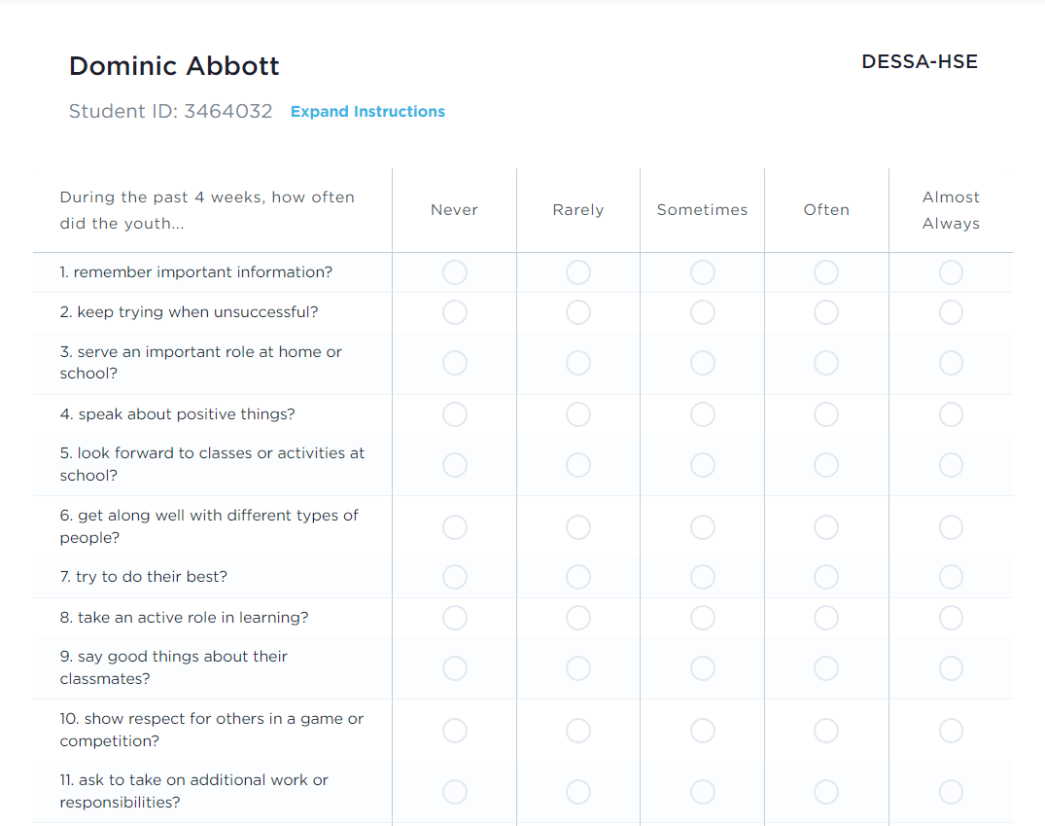
DESSA-HSE
9th-12th
Assessment of 6 competency areas
Educators Complete
Scores:
Social and Emotional Composite (SEC)
6 competency areas
Notes:
The high school version of the DESSA assessment mirrors that of the HSE screening tool, with the differences in language used to identify the student (“youth”) and the frequency scale options, as well as the skills measured for in 9th-12th grades, which we can see here in the examples on screen.
Just like the K-8 version, this follow-up assessment allows for educators to have a deeper insight into the strengths of an individual student, with t-score results in each of the 8 competency areas.
It may help to just note here that there IS a student self-report version for the high school level that students complete—this is not an assessment we will cover today (that is a different training session), but just to be aware of that as an option, in case your school or district is utilizing it or may plan to utilize it in the future.

Slide 16
DESSA Results
T-scores are categorized into 3 descriptive ranges
Need for Instruction T-Scores: 40 and below | Typical T-Scores: 41 – 59 | Strength T-Scores: 60 and above
Reflects a lack of skill acquisition
Notes:
Both the DESSA-mini and the DESSA report results using T-scores
T-scores are categorized into three descriptive ranges, and as strength-based measures, higher T-scores mean a higher level of social and emotional competence.
Scores of 60 and above are considered a strength; scores between 41-59 inclusive are considered typical (demonstrating typical patterns of development); and scores of 40 and below indicate a need for instruction.
A common implementation practice includes completing a DESSA-mini screener for all students. For the students that demonstrate a need for instruction on the DESSA-mini, then a full DESSA assessment is then completed.
(Click) The term need for instruction was thoughtfully chosen to convey that the student needs support and instruction in this area.
That is, it reflects that the student has not YET acquired these skills.
It is NOT a personality trait or deficit.
Rather, it is simply a lack of skill acquisition.
So, the goal is not to label or stigmatize students within the “Need” range, but instead, it’s used to increase our awareness as educators that a student needs our instruction, assistance, and support in acquiring and practicing these important skills.
Once we’ve identified a need for instruction, it’s OUR responsibility to have a system or plan in place to support skill development and provide that instruction. We the information from the follow-up DESSA assessment to gather really specific information on a student so that we can support them moving forward.

Slide 17
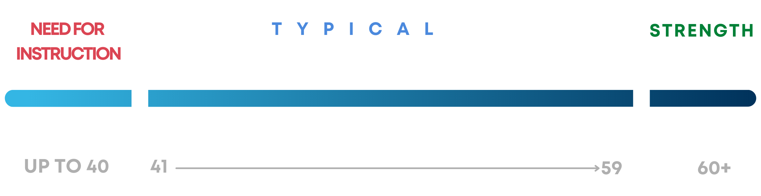
DESSA: Continuum of Scores
Norms
16%
68%
16%
Notes:
The DESSA standardization sample closely approximated the student population of the United States with respect to age, gender, geographic region of residence, race, ethnicity, and socioeconomic status.
From the standardization sample, we can anticipate that the majority of students (68%) will demonstrate typical patterns of development when it comes to their social and emotional skills, and that 16% of students will demonstrate strengths in these areas, as well as 16% of students indicating a need for instruction.
The DESSA manual details the development and standardization of the assessments, including the psychometric properties (validity and reliability), and specific directions for administering, scoring, and interpreting the results of the assessments. The DESSA manuals can be downloaded from the Aperture website (under the “DESSA” tab), for more information about those details.

Slide 18
DESSA Uses
Universal Screening
Progress Monitoring
Outcomes Measurement
School Leaders
Inform school improvement planning
Support funding requests
Notes:
Earlier in the session, we identified data collection as an important part of any SEL program, as it can help to drive meaningful change and evaluate outcomes.
The DESSA assessment is utilized for universal screening, progress monitoring, and outcome measurement, including program evaluation.
The implementation of this data collection process may depend on your school’s approach to SEL, and we will cover the general implementation timeline later.
(Click) Additionally, this information will be beneficial for your roles as school leaders, as it can help to inform school-wide improvement plans and support funding requests. You may choose to utilize this data to create school-wide goals or to demonstrate the value of services, supports, and resources for students and educators on grant or other funding applications.

Slide 19
DESSA Reflections
After learning about the DESSA, what questions, curiosities, or epiphanies do you have?
Questions
Curiosities
Aha!
Notes:
To recap, the DESSA-mini screener results in one score that provides an overall picture of the student’s social and emotional skills. Using the t-score and descriptive category that is yielded, we can consider how best to support the student’s growth in social, emotional, and academic areas.
We understand it was a lot of information, so let’s debrief in a reflection. As you reflect on what you learned about the DESSA, what questions, curiosities, or epiphanies do you have?

Slide 20
Think-Pair-Share
How might a strength-based approach improve:
Conversations about student support?
Culture and climate?
Engagement with families?
Notes:
We’ve talked a lot about a strength-based approach and how that DESSA can support that mindset. In a few moments I will invite you into breakout rooms to talk about how a strength-based approach can improve elements of school culture and climate.
Before we do that though, I want to give you an opportunity to record your thoughts in your Workspace document. Let’s take about 2 minutes to jot down some thoughts around how a strength-based approach can improve conversations about student support, culture and climate, and family engagement.
OPEN Breakout Rooms 7 mins

Slide 21
WHAT IS THE DESSA?
HOW TO COMPLETE RATINGS
THE EDUCATOR PORTAL
IMPLEMENTATION OVERVIEW
OPTIMISTIC CLOSURE
AGENDA
Notes:
Now that we know what the DESSA is, let’s practice how to use it. It’s time to complete a rating.

Slide 22
Tips for Completing Ratings
1. Be intentional in observation
2. Get familiar with DESSA items
3. Be strategic
4. Think broadly
5. Stick to YOUR facts
6. Plan your rating time
Notes:
In just a moment, we’ll take some time to complete a DESSA-mini as our next engagement activity. First, we’ll include some tips or best practices for completing ratings, whether you are the rater or you are supporting this implementation by sharing this information with staff.
(Click) Be intentional with observations. Doing this helps you to get to know your students better, puts on a positive lens to look for strength-based behaviors, and also helps you to understand more about social and emotional competence. It also allows for you to be less biased when observing your students.
(Click) Familiarize yourself with the DESSA assessment questions. The more you know about the assessment, the easier your intentional observation will be and the more accurately you will be able to complete your rating. You can download the DESSA-mini/DESSA you will use from the support portal. I will show you where to find it later when we look at the online system. Read it over, think about the behaviors it asks about, and when and how you might observe them. Do a sample rating on someone you know for practice.
(Click) Be strategic and think about activities that provide you a chance to see specific skills, and ways to provide students with an opportunity to demonstrate specific skills. Remember, to observe intentionally and from a strengths-based lens, do not complete observations during a time when you know the student is struggling or exhibiting maladaptive behaviors. (Click) Think broadly and try not to overthink or over analyze especially when completing the rating for the DESSA-mini. Ask yourselves simple questions like this: What can students do on their own? How often do they do it?
(Click) Stick to the facts. Raters will base their rating on the last 4 weeks with the student, not an interpretation or what they have “heard” about the student. Remember an intentional observation and accurate rating will be unbiased and based only on what the rater views during the observation period.
(Click) Finally, it’s important to plan your rating time. School leaders are encouraged to identify a time for educators to complete the ratings, such as during or in lieu of a staff meeting or PLC.

Slide 23
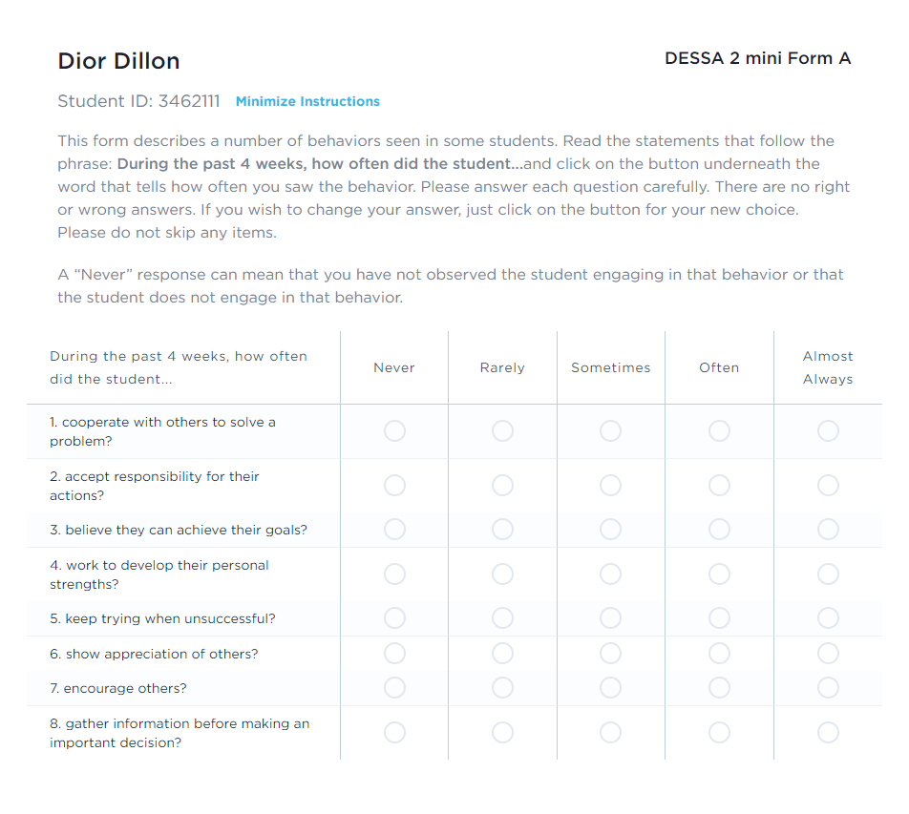
Practice: Completing the DESSA mini
Directions:
On your own, complete the rating on yourself or with someone in mind
Consider areas of strength based on your responses
Notes:
Let’s practice completing the DESSA-mini.
Directions:
On your own, complete the rating on yourself or with someone in mind
Consider areas of strength based on your responses

Slide 24
Competency Connection
Based on your knowledge of the DESSA, which competency represents your greatest strength?
Which competency represents your greatest area of need?
How can you use your strengths to improve your area of need?
Notes:
In a moment, I will invite you to reflect on the following questions individually, and record your response on your workspace document: “Based on your knowledge of the DESSA, which competency represents your greatest strength?, Which competency represents your greatest area of need?, and How can you use your strengths to improve your area of need?”
Alright, I am about to open our breakout rooms, but before I do I want to encourage you to introduce yourself using the information on the slide when you first get into the room, and then answer the questions from there. [Enter Intro Info into chat]
[Open breakout rooms- 2 participants per room- set timer for 4 minutes so at 5 minutes everyone comes back]
After breakout- Welcome back everyone! We’ll take 2 takeaways for our whole group share.

Slide 25
WHAT IS THE DESSA?
HOW TO COMPLETE RATINGS
THE EDUCATOR PORTAL
IMPLEMENTATION OVERVIEW
OPTIMISTIC CLOSURE
AGENDA
Notes:
Now that we’ve covered the DESSA and ratings, let’s walk through the Educator Portal!

Slide 26
Aperture System User Roles
Can generate and view all reports for the program, sites, and students.
Can generate and view reports from their site only.
Can generate and view reports for their assigned students.
Notes:
There are 3 different types of user access. The user access in the Aperture System dictates what information is displayed on the dashboard and the types or amount of data viewable in your Aperture System account.
(Click) First, the Program Administrator access is typically provided to district leaders or other staff responsible for setting up rostering, assessment windows, and rating assignments. Program administrator access will allow the user to view data for all sites within their district.
(Click) Next, the Site Leader access is generally provided to school or site-based leaders, including Principals and Assistant Principals, as well as other leaders that may need access to data across the campus, such as School Counselors, School Psychologists, Social Workers, etc. Site Leader access will allow the user to access to data for their specific site.
(Click) Finally, the Rater access is provided to educators that are assigned to complete ratings within the Aperture System. The Rater access allows for educators to complete DESSA assessment for the students that they have been assigned to rate and view the data for their assigned students.

Slide 27
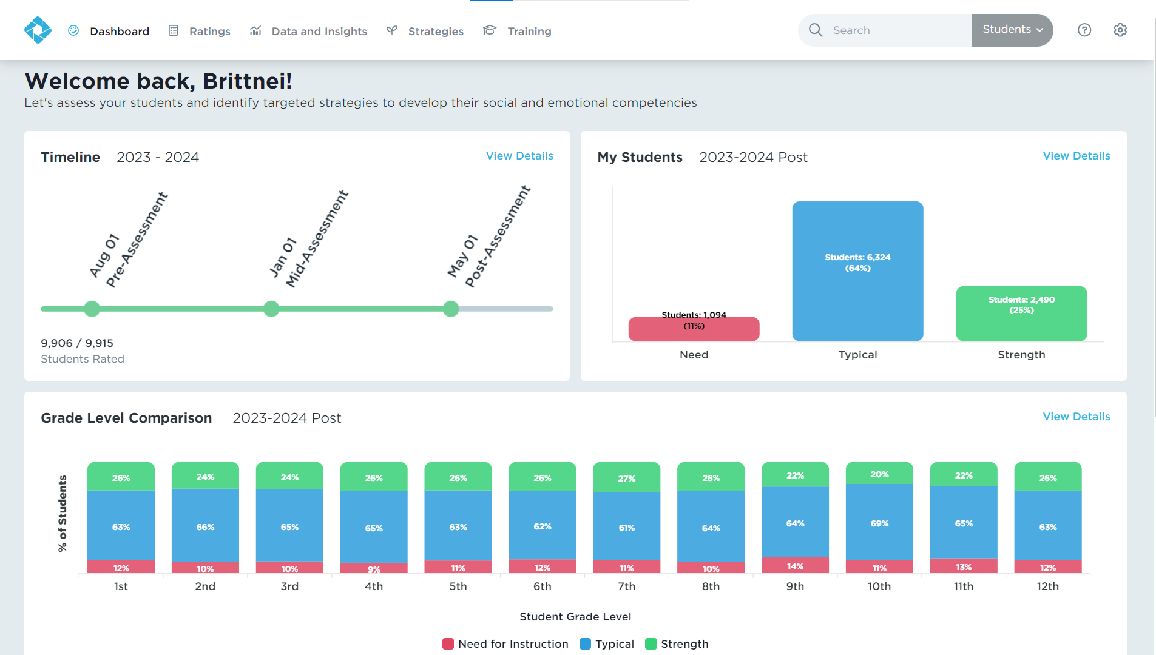
Site Leader Dashboard
Site Leader Dashboard
Notes:
When you log in to your account, the dashboard will provide a quick snapshot of the rating progress and data that has been collected based on the current or most recent rating window.
The user access in the Aperture System dictates what information is displayed on the dashboard and the types or amount of data viewable in your Aperture System account.

Slide 28
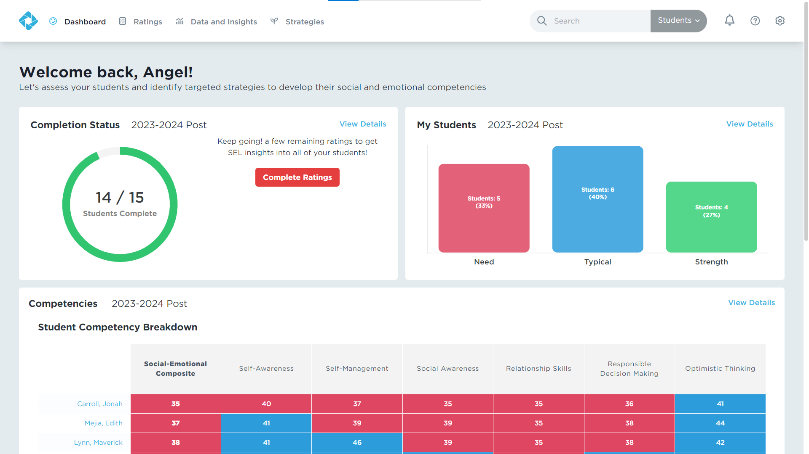
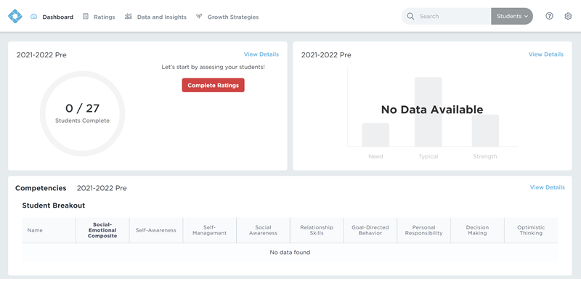
Educator Dashboard
Educator Dashboard
Notes:
When a user first logs into the Aperture System, the dashboard will likely appear blank since there won’t be any ratings completed yet and therefore, there won’t be any data in the system.
Once ratings begin to occur that data will populate in the system and be able to be viewed here as well in the data and insights tab, which we will go over in more detail in a few moments.

Slide 29
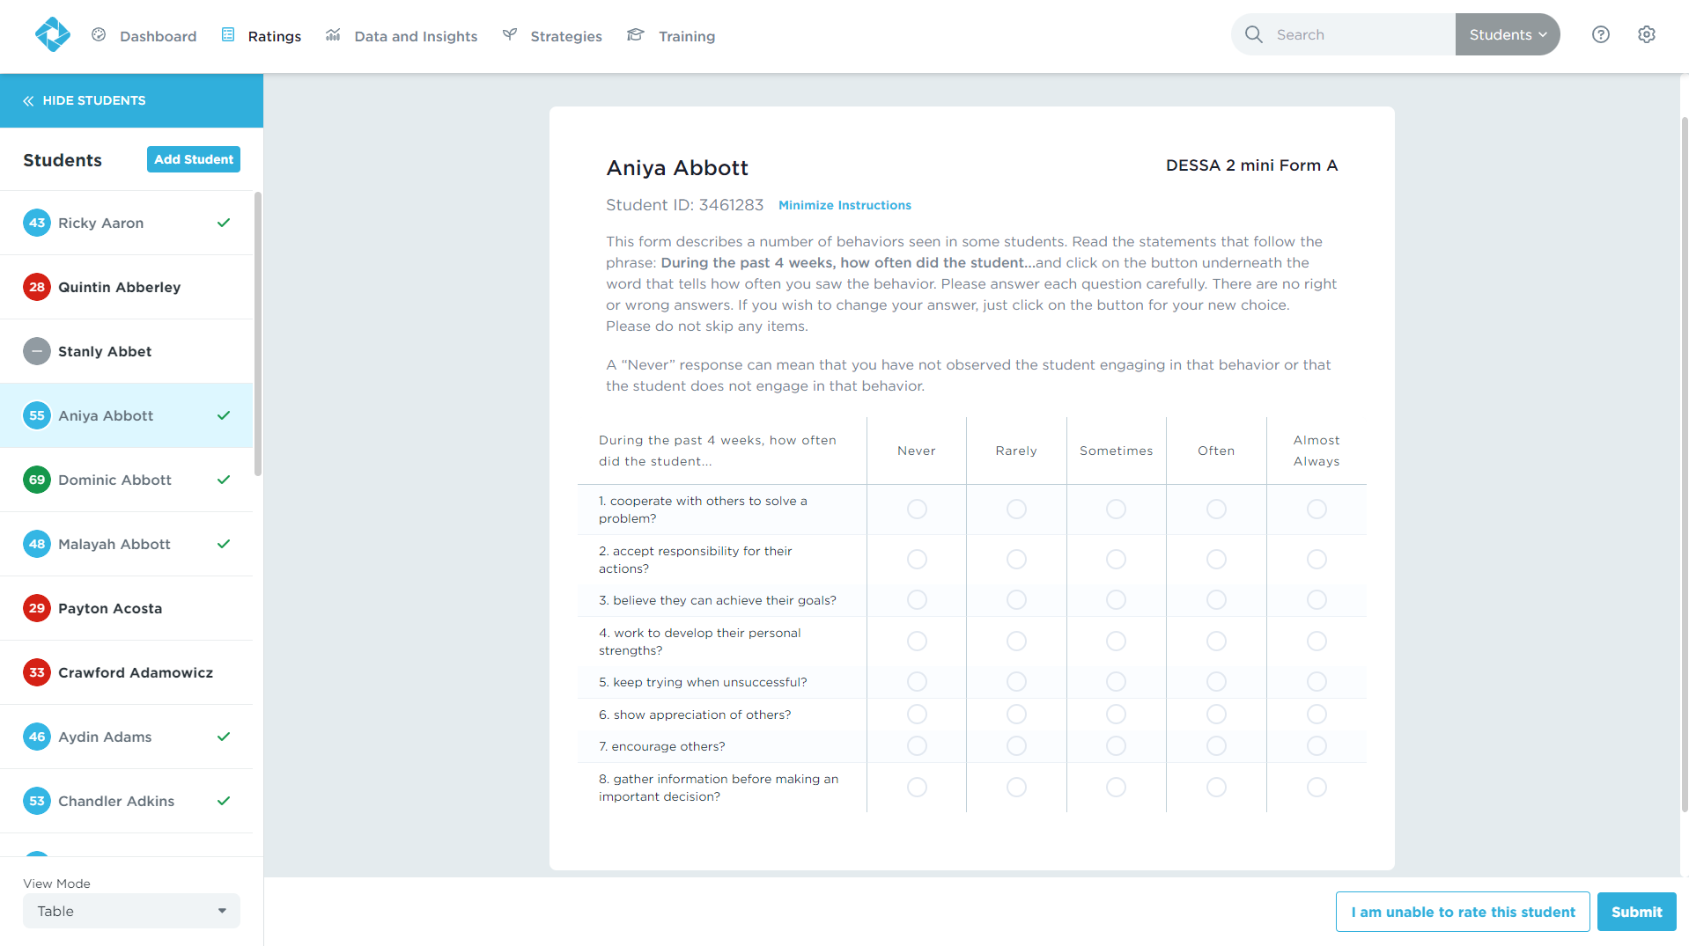
Complete Ratings
Ratings tab shows assigned roster of students.
Answer all DESSA 2 mini questions.
Educators can skip up to 2 questions on DESSA 2
Notes:
Under the “Ratings” tab, educators will be able to view their assigned roster of students.
As a reminder, an educator will have to answer all 8 questions on a DESSA-mini. You can skip a question and come back to it; however, you cannot skip a question and complete the rating.
The circles on the left side of the student names indicate whether or not they’ve been rated, and the descriptive range in which they scored.
Gray signifies that they have not been rated, red means they have a need for instruction, blue means they scored in the typical range, and green means they scored in the strength range.
Students with a check mark have had a DESSA 2 completed.
Clicking on a student with a red circle and no check mark will automatically initiate a full assessment.
Click on a student with a blue or green circle and no check mark, will show you their T-Score and give you the option to progress monitor.

Slide 30
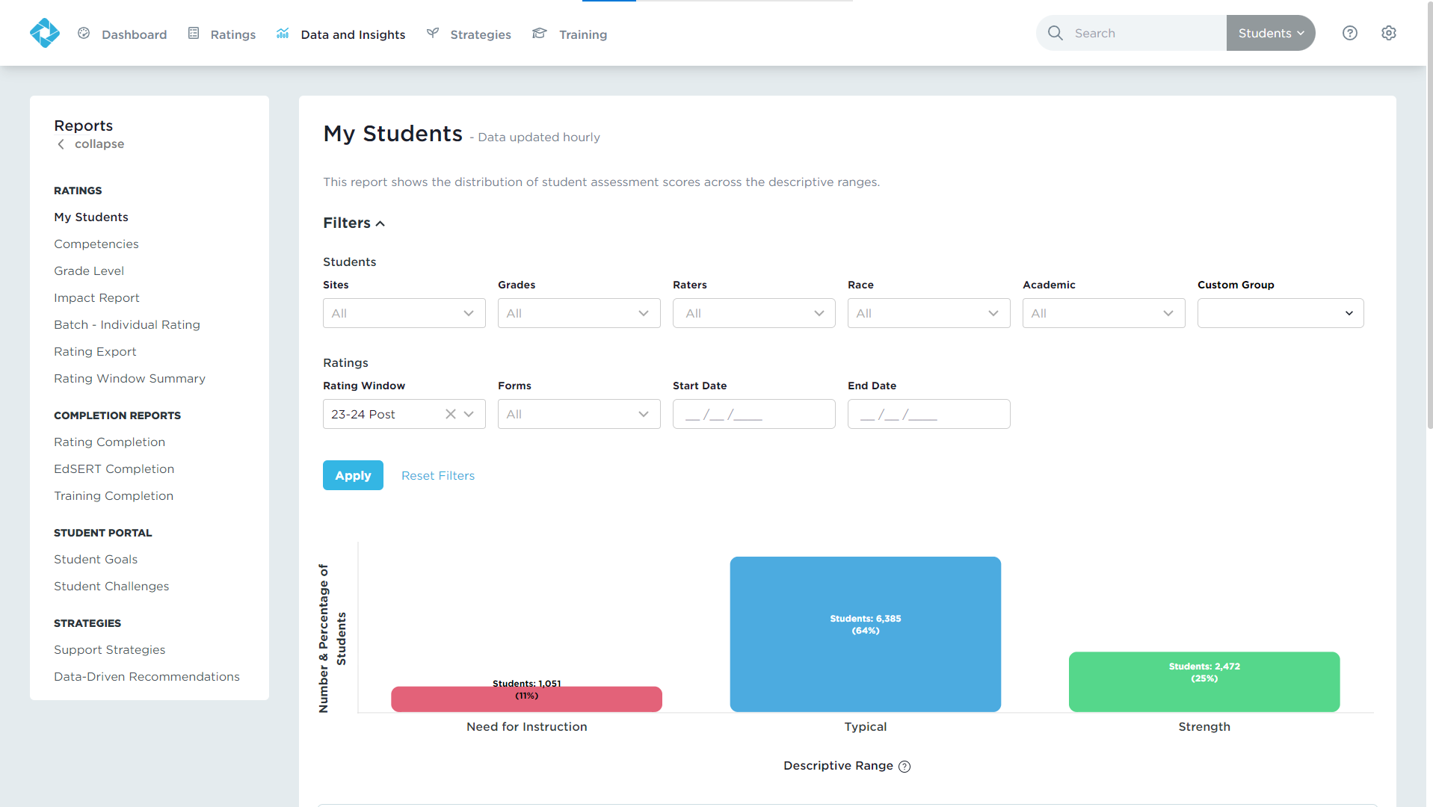
Data & Insights
Real-time results
Interactive, filterable charts
Downloadable reports
Notes:
Data and Insights will give you just that: data from the DESSA assessments and insights into how you can support your students.
You’ll get Real-time results, Interactive, filterable charts, and Downloadable reports

Slide 31
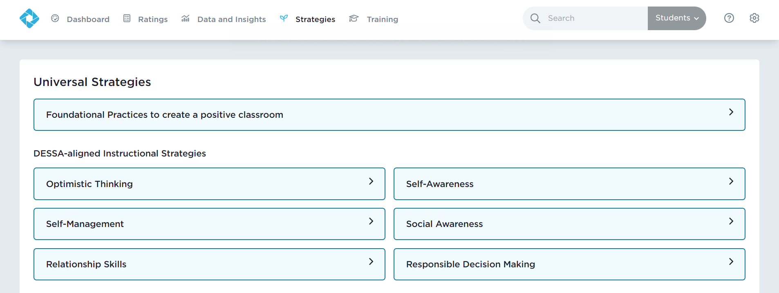
DESSA-aligned Strategies
Notes:
Under the Strategies tab, there are resources for SEL instruction categorized by competency and grade level.

Slide 32
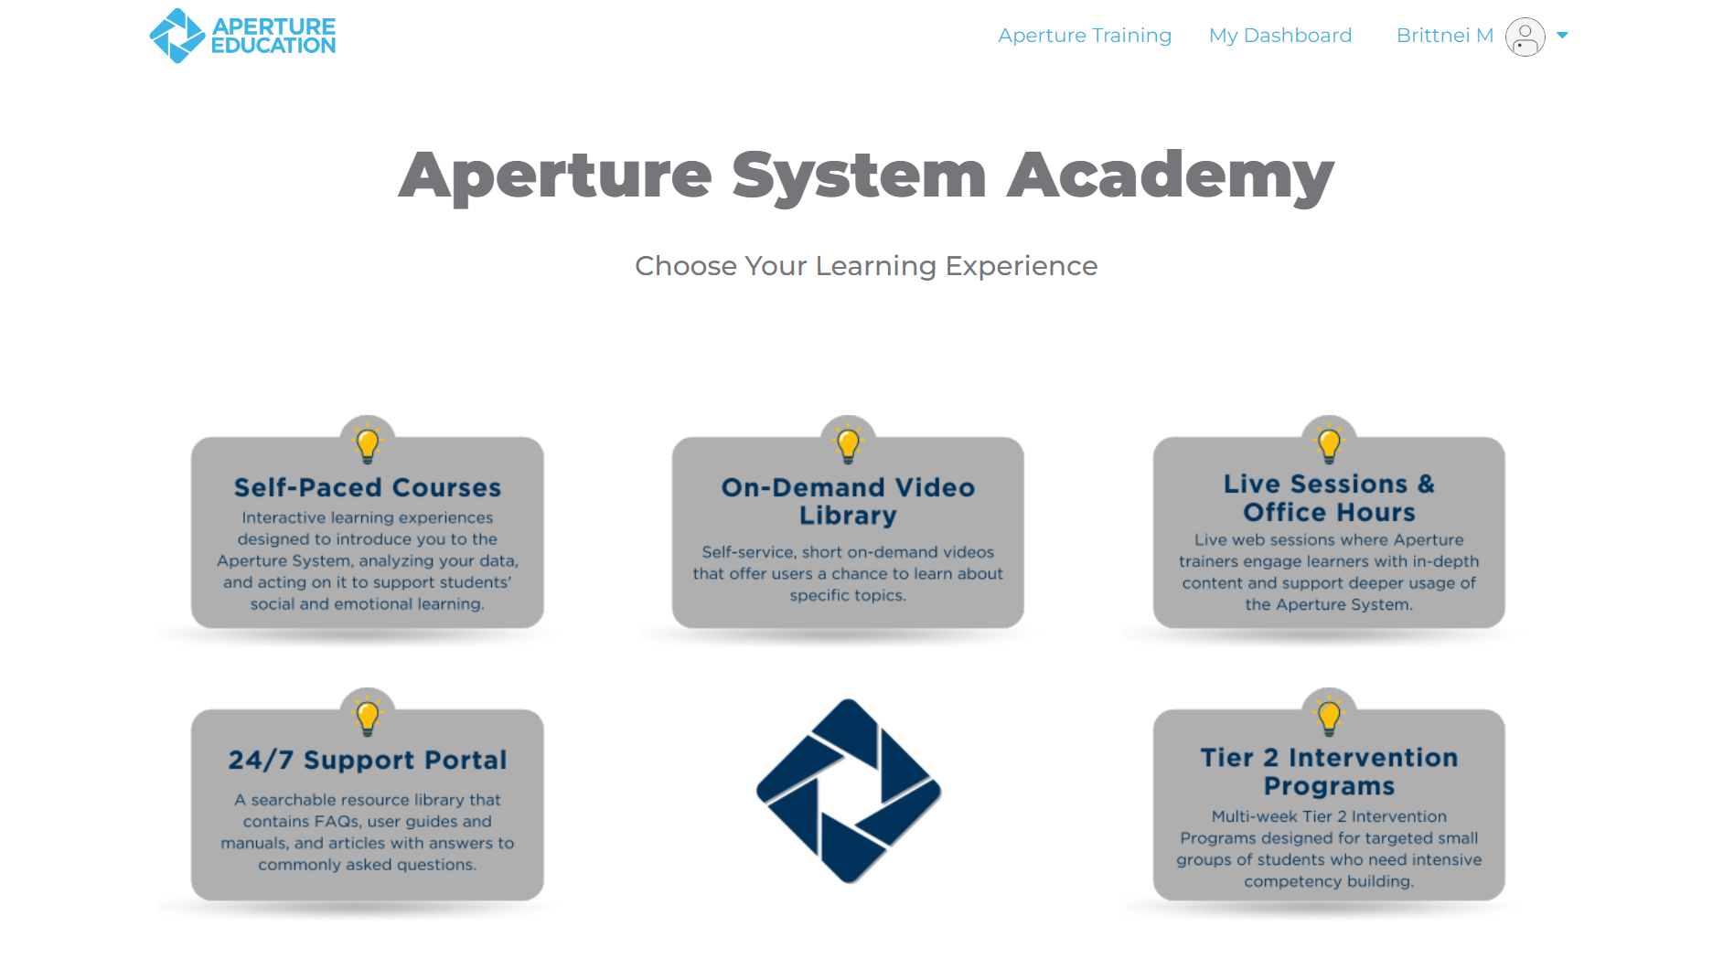
Training
Notes:
Choose your preferred learning modality in our Academy!
We offer self-paced courses for individuals who are new to the DESSA or those who just need a refresher.
Our on-demand video library provides short self-service videos that help users with DESSA implementation, and we offer live monthly office hours on pre-selected topics as well.
Our Support Portal is open 24/7, offering resources to help guide users through the DESSA system.

Slide 33
WHAT IS THE DESSA?
HOW TO COMPLETE RATINGS
THE EDUCATOR PORTAL
IMPLEMENTATION OVERVIEW
OPTIMISTIC CLOSURE
AGENDA
Notes:
So, we know what the DESSA is, we know how to rate students using the DESSA, and we’ve ventured into the Educator Portal. Let’s now take a step back to talk through how all of this information fits within the full scope of implementation.

Slide 34
Implementation Overview
Pre-Assessment
Post-Assessment
End of School Year
Start of
School Year
Mid-Assessment
Ongoing, universal, and data-driven SEL Instruction
Targeted intervention and individualized instruction, as needed
Notes:
It helps to calibrate on the what the DESSA assessment process typically includes, keeping in mind that every district or school site may have some different processes in places based on their implementation plan
(Click) Generally speaking:
After the beginning of the school year, once the educator has had a minimum of 4 weeks to observe their class, all students are screened using the DESSA-mini. A follow up DESSA assessment is typically completed if a student demonstrates a need for instruction based on the DESSA-mini results.
A mid-assessment rating window is opened for educators to gather more data and a post-assessment is completed prior to the end of the school year
(Click) Throughout the school year, ongoing, universal, and data-driven instruction of social and emotional skills is provided to all students, and targeted intervention and/or individualized instruction is provided to students who demonstrate a need for further support in specific skills areas, typically in the small group or individual setting
Additionally, throughout the school year, staff are having discussions about the data they collect or best practices for supporting students in this development, and are working together to create a supportive school culture and climate, the foundation for students to grow
(Click) A key point to keep in mind, regardless of what this process may look like at your site, is that the teaching and learning of social and emotional competencies are continuous.
Educators are constantly teaching these skills, whether it’s through explicit instruction, modeling, or relationship building with students.
Students are constantly learning from each other, about themselves, and by interacting with adults within their school environment.
It’s not just during the rating windows of collecting data that we are actively involved in this process; it’s all year round.

Slide 35
Keep in Mind
Implementation
Process
Intentional Planning
Notes:
With that said, important to keep in mind that: IMPLEMENTATION is a PROCESS that requires intentional PLANNING.
There is naturally a continuum or life cycle of any kind of programmatic implementation
Processes that contribute to successful and sustainable implementation take time and not every district, site, or educator is going to be in the same part of that process at the same time.
And that is okay, we can trust the process. As long as we have created time to be intentional with our planning, to consider the different key components and what that looks like at our individual sites and within our individual roles, as well as the roles of others at our site and how we are collectively working together
It’s crucial for this planning to be not only realistic or feasible, but also valued by those key stakeholders involved

Slide 36
Implementation Planning Resource
School Leader Implementation Checklist
☐ | 1. Ensure that teachers have training on the DESSA. Training should include completing the DESSA-mini and the DESSA, as well as how to review and understand results .
☐ | 2. Designate a rating window for your first rating between 4-6 weeks after school start.
☐ | 3. Provide time for teachers to complete DESSA-mini ratings. For example, some sites designate a common time/day or period to ensure all ratings are completed.
☐ | 4. Schedule and provide time for teachers to complete DESSA ratings for students who demonstrate a need for instruction.
☐ | 5. Create a process and coordinate the review of DESSA-mini results at school, grade, class levels.
☐ | 6. Schedule time to review DESSA results.
☐ | 7. Schedule mid-year ratings for DESSA mini and DESSA. Schedule a reminder to teachers 4-6 weeks prior so they are prepared to complete their ratings.
☐ | 8. Schedule end-of-year ratings. Schedule a reminder to teachers 4-6 weeks prior so they are prepared to complete their ratings.
☐ | 9. Schedule time to review, reflect on, and share results with stakeholders.
Notes:
This School Leader Implementation Checklist outlines the steps of implementation, starting with preparing raters and school-based teams with training, designating pre-mid-and post-rating windows throughout the year, and analyzing and utilizing the data.
The full implementation guide with this checklist and other resources can be found here in the Support Portal.

Slide 37
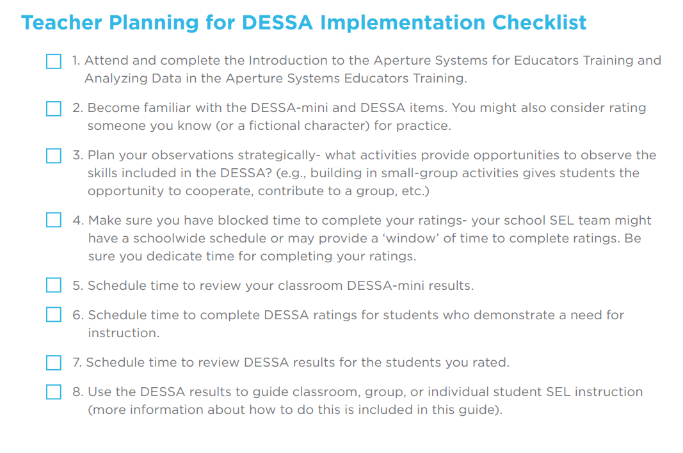
Implementation Planning Resource
Notes:
This School Leader Implementation Checklist outlines the steps of implementation, starting with preparing raters and school-based teams with training, designating pre-mid-and post-rating windows throughout the year, and analyzing and utilizing the data.
The full implementation guide with this checklist and other resources can be found here [ ], but is also linked to your workspace document.

Slide 38
Next Steps: Analyzing Data in the Educator Portal
Utilize data at district, school, and classroom levels
System Setup
Getting Started with the DESSA
First Rating Period
Analyzing Data in the Educator Portal

Slide 39
WHAT IS THE DESSA?
HOW TO COMPLETE RATINGS
THE EDUCATOR PORTAL
IMPLEMENTATION OVERVIEW
OPTIMISTIC CLOSURE
AGENDA
Notes:
Well friends, we’ve reached the end of the road. Let’s end our time together with an Optimistic Closure.

Slide 40
Optimistic Closure
Based on your takeaways, what is one way the DESSA System will help improve your practice?
Notes:
We’ve now come to our final reflection. For our optimistic closure today, I want you to think about your gleanings from today’s session.
Based on your takeaways, what is one way the DESSA System will help improve your practice?
I invite you to record your final takeaways on your workspace document and feel free to add them to the chat if you so desire. (2 mins)

